Slide 1
The Pasteur Award: Legends, Mentors, and Colleagues

Slide 2
“Too be honest, I do not feel that I deserve to be in the company of so many of the transformative figures who’ve been honored by this prize.”

Slide 3
“Too be honest, I do not feel that I deserve to be in the company of so many of the transformative figures who’ve been honored by this prize.” Barack Obama. 2009 Nobel Peace Prize Lecture.

Slide 4
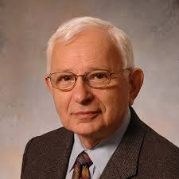
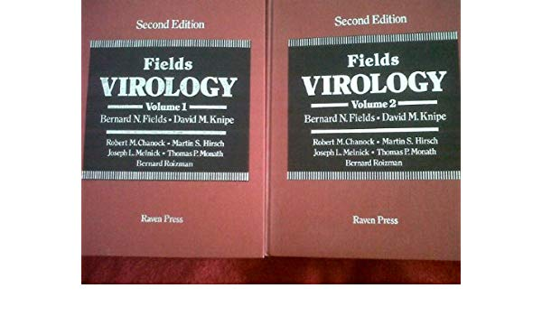
1972 Dr. Bernard Roizman

Slide 5
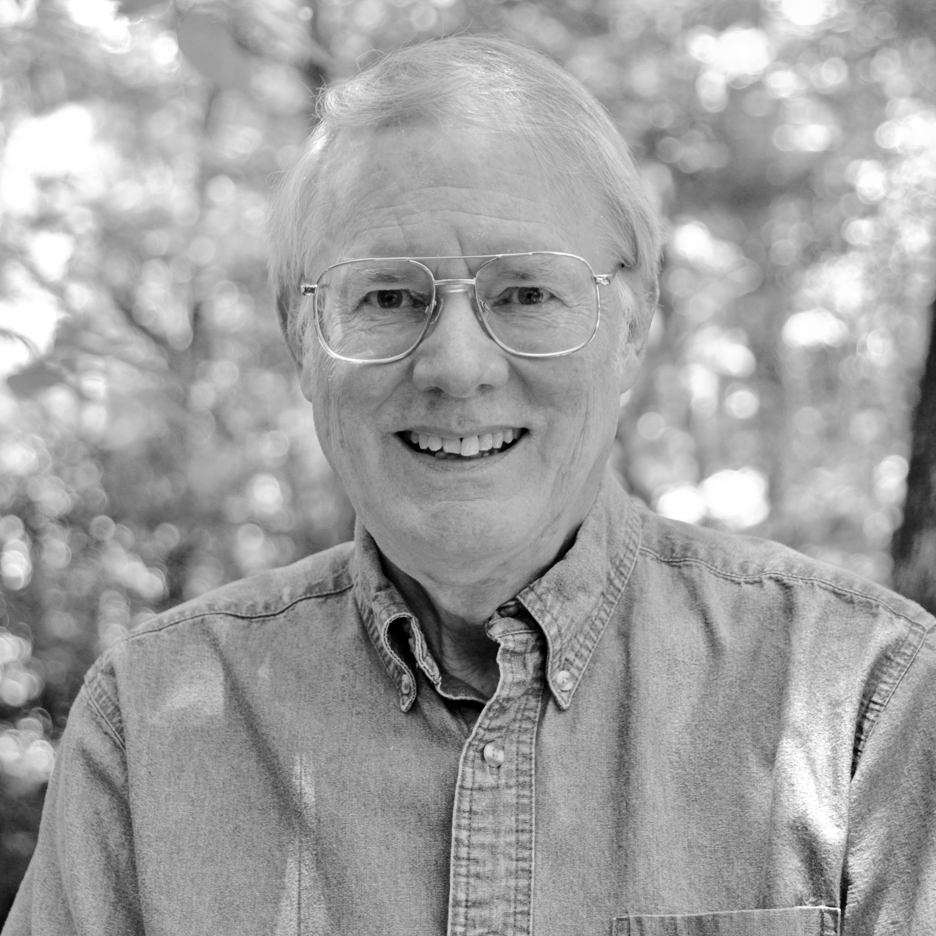
Dr. Kent Wilcox (Six degrees of Kevin Bacon)

Slide 6
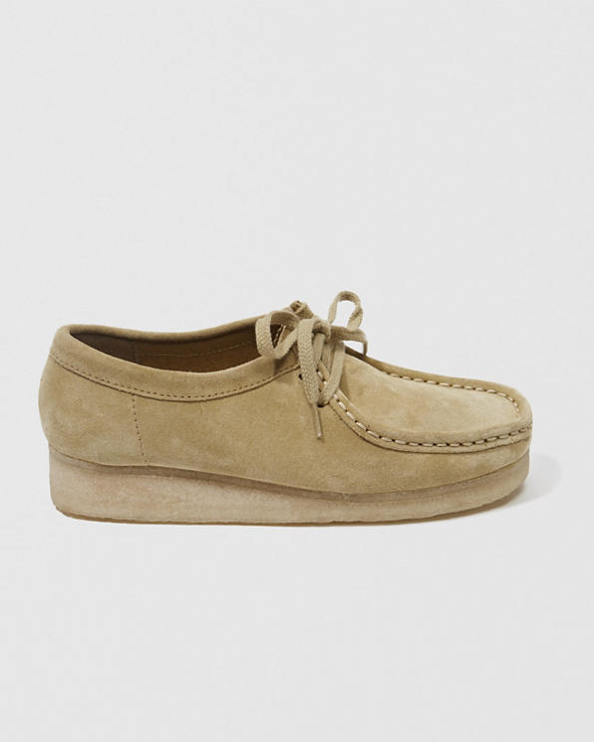
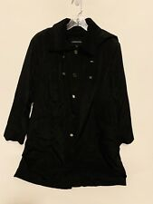
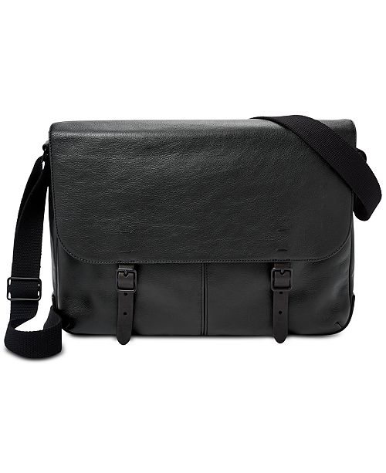
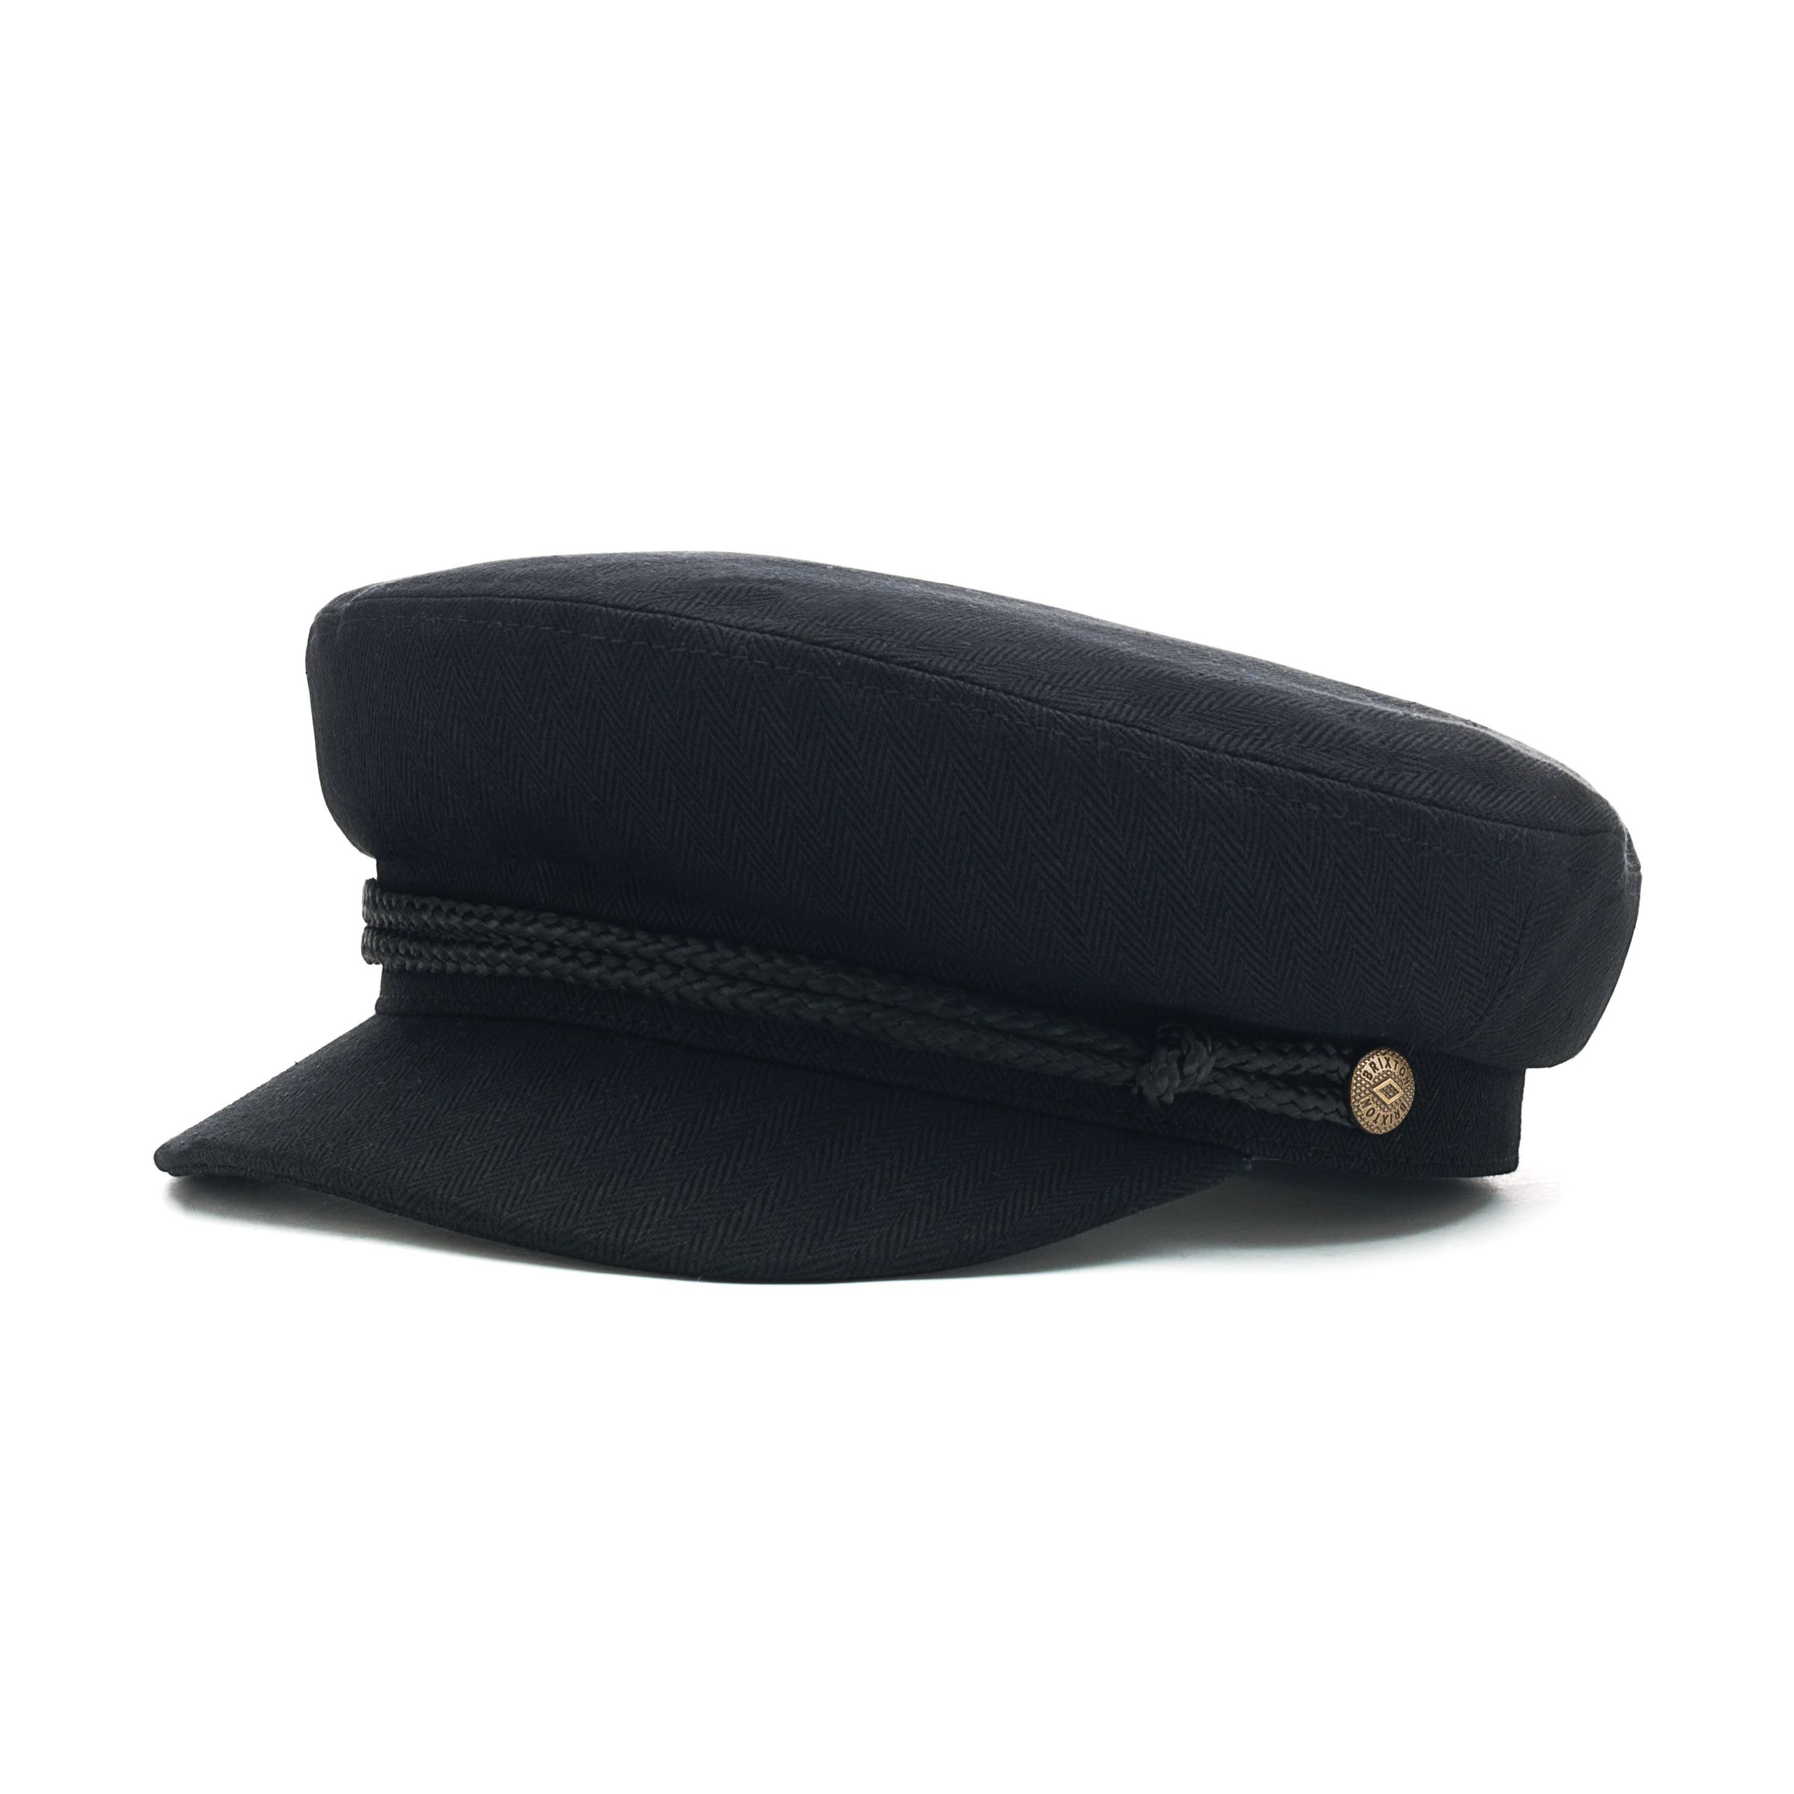
1983 Dr. B. Wesley Catlin
B. Wesley Catlin joined the department as Assistant Professor in 1950 and was promoted to Associate Professor in 1954. Catlin served as Acting Chairman of the department while Dr. Kappus was in San Salvador in 1960 and 1961.

Slide 7
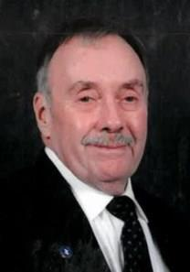
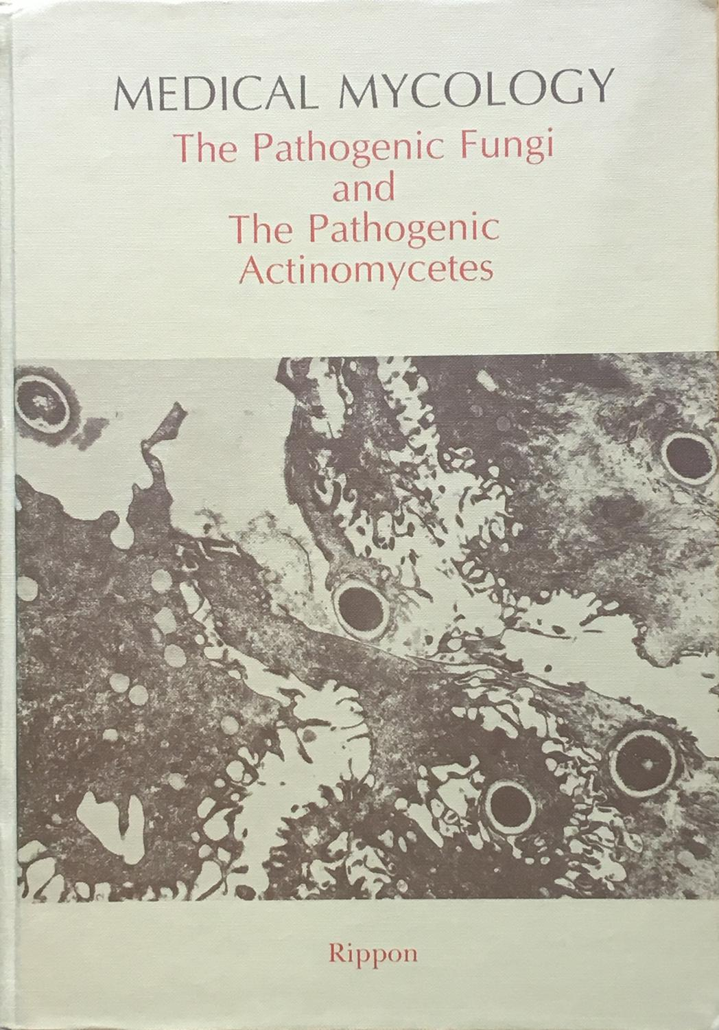
1984 Dr. John W. Rippon

Slide 8
1988 Dr. Josephine A. Morello

Slide 9
1990 Dr. Eileen Randall

Slide 10
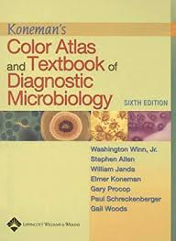
1995 Dr. Elmer W. Koneman

Slide 11
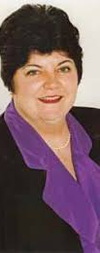
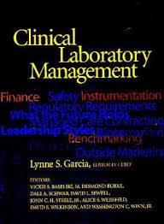
1998 Ms. Lynne Garcia

Slide 12
2000 Dr. Ron Zabransky

Slide 13
2003 Dr. John Washington

Slide 14
2005 Dr. James Tiedge

Slide 15
2007 Dr. Patrick R. Murray

Slide 16
2008 Dr. Geraldine Hall

Slide 17
2010 Dr. Paul Schreckenberger

Slide 18
2012 Dr. Michael Miller

Slide 19
2013 Dr. Roberta Carey

Slide 20
2015 Dr. Fred Tenover

Slide 21
2016 Dr. Richard (Tom) Thomson

Slide 22
2017 Dr. Karen C. Carroll

Slide 23
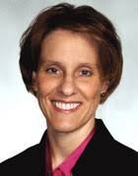
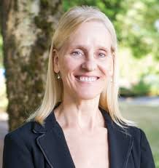
2018 Dr. Susan E. Sharp

Slide 24
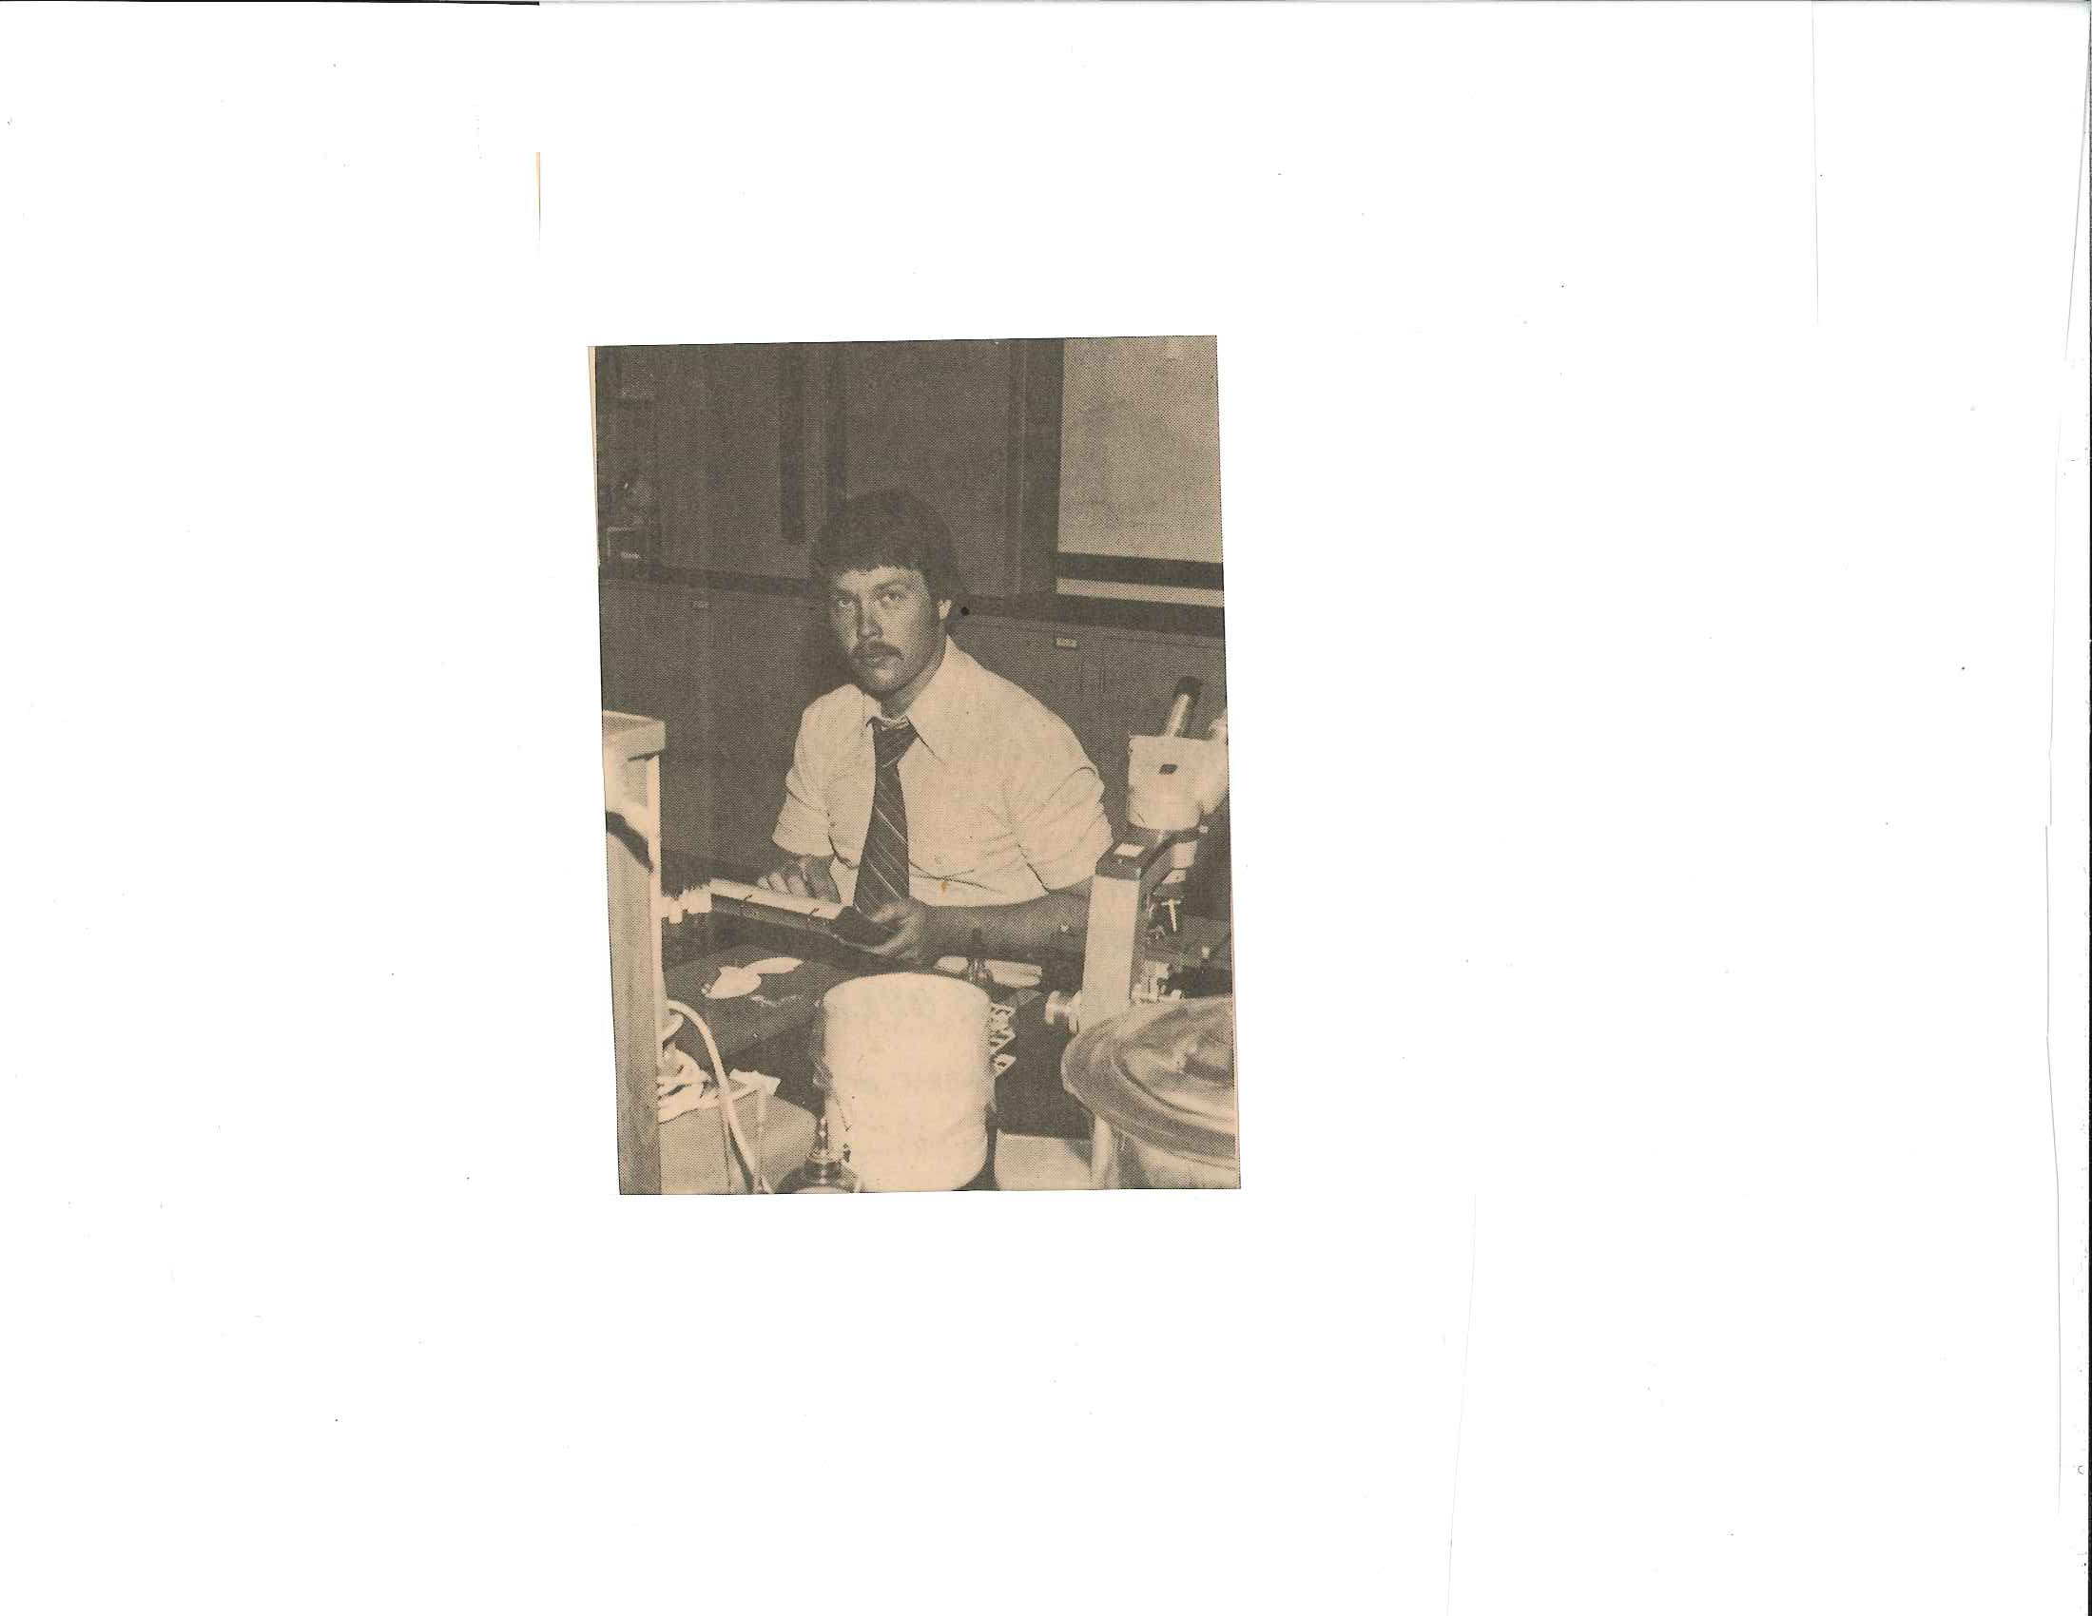
2019

Slide 25
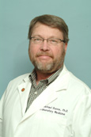
2019

