Slide 1
Is Faster Actually Better? The Role of Rapid Blood Culture Diagnostics in Patient Outcomes and Cost-effective Patient Care
Erin McElvania, Ph.D. D(ABMM)
Director of Clinical Microbiology, NorthShore University Health System
Clinical Assistant Professor of Pathology,
University of Chicago, Pritzker School of Medicine

Slide 2
Disclosures
Luminex, Consulting and Research Funding
BD, Consulting and Research Funding

Slide 3
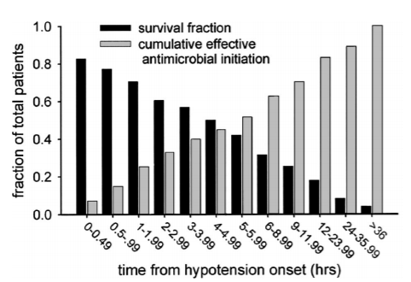
Clinical Importance of Blood Stream Infection Detection
Rapid identification and susceptibility testing of blood culture pathogens is a crucial function of the clinical microbiology laboratory
For each hour optimal therapy is delayed morbidity and mortality increase
A. Kumar et al. Crit Care Med (2006) 34:1589-1596

Slide 4
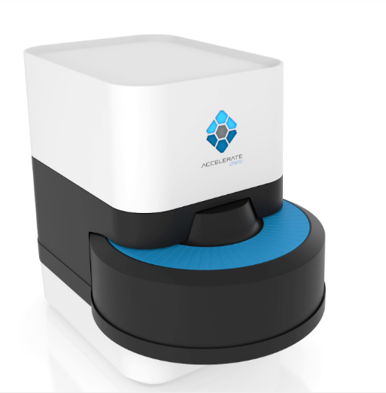
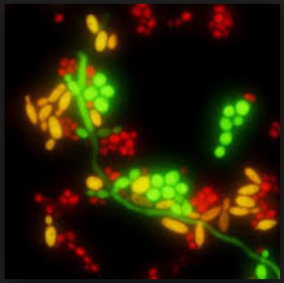
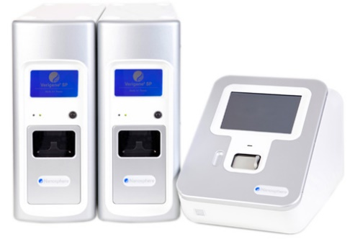
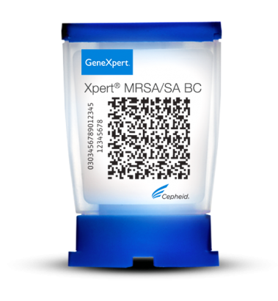
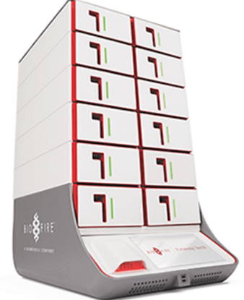
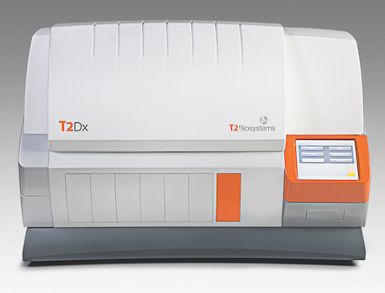
Rapid Diagnostic Testing From Blood
Rapid Susceptibility
MALDI-TOF
Mass Spectrometry
Hybridization Probe
1990s
2000s
2010s
Hybridization
Multiplex PCR
Direct from whole blood
Notes:
Add direct from blood and rapid AST images

Slide 5
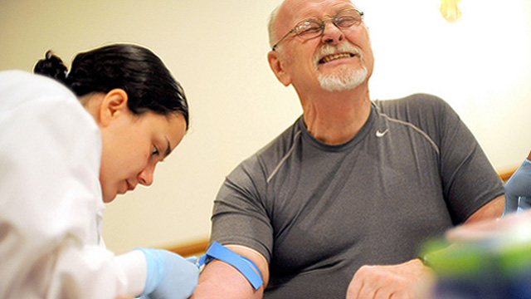
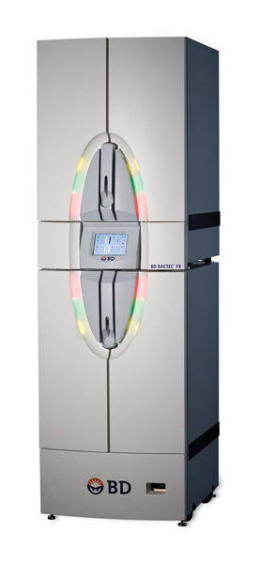
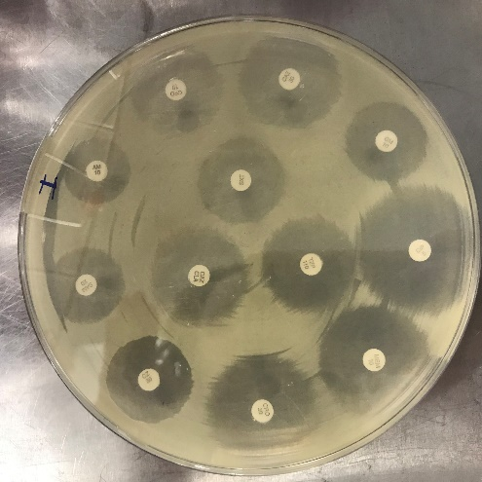
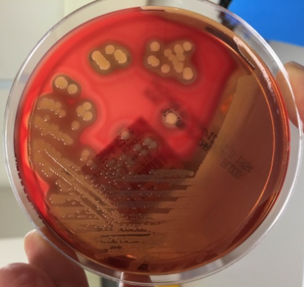
Rapid Diagnostic Testing From Blood
Positive
Rapid Pathogen
Detection
Molecular
Identification
L. Samuel. JALM (2019): 631-642

Slide 6
Rapid Diagnostic Tests (RDTs)
Easy to use
Rapid turnaround time
COST
Notes:
We need to justify cost to ourselves and hospital administration

Slide 7
Rapid Diagnostic Tests (RDTs)
We must make the case that the cost justifies the testing
Easy to use
Rapid turnaround time
COST
Notes:
We need to justify cost to ourselves and hospital administration

Slide 8
Rapid Diagnostic Tests (RDTs)
We must make the case that the cost justifies the testing
Reduced healthcare costs
Improved patient outcomes
Easy to use
Rapid turnaround time
COST
Notes:
We need to justify cost to ourselves and hospital administration

Slide 9
Rapid Diagnostic Tests (RDTs)
We must make the case that the cost justifies the testing
Reduced healthcare costs
COST
Improved patient outcomes
Easy to use
Rapid turnaround time
Notes:
We need to justify cost to ourselves and hospital administration

Slide 10
Antibiotic Usage…Room for Improvement
30-50% of antibiotics prescribed in hospitals are unnecessary or inappropriate
Unnecessary side effects
Development of antibiotic-resistant bacteria
Risk for Clostridium difficile infection
Big opportunity to use RDTs to rapidly optimize antimicrobial therapy
Centers for Disease Control and Prevention, 2019

Slide 11
Outcome Studies for RDTs
The ultimate determination of success for any test is its effect on patient outcomes
In the absence of outcome studies, we infer “improved clinical outcomes” including…
Decreased time to effective antimicrobial therapy
Reduced hospital length of stay (LOS)
Reduced intensive care unit (ICU) LOS
Decreased patient mortality
Reduced hospital costs

Slide 12
Outcome Studies for Blood Culture RDTs
Most studies focus on positive blood cultures
Organism identification and resistance determinants direct from positive blood culture broth
Organism identification directly from blood
Organism identification and rapid susceptibility testing from positive blood culture broth
Studies look at all positive blood cultures or particular subsets of organisms
Notes:
Separated by potential impact
All blood cultures
Staphylococcus aureus
Enterococci
Multi-drug resistant Gram-negative bacteria
Yeast

Slide 13
Outcome Study Design
Retrospective vs. Prospective Data Collection (Quasi-experimental)
Historical Testing Method
Implementation
of RDT
RDT Testing Method
[+/- Antimicrobial Stewardship]
Challenges
Does not account for changes in the patient population, infectious disease rates, or other changes in the hospital

Slide 14
Outcome Study Design
Randomized Control Study
[+/- Antimicrobial Stewardship]
Historical Testing Method
RDT Testing Methods
Challenges
Requires enormous resources to randomize and follow patients in real time
Regulatory approval

Slide 15
Impact of Blood Culture RDTs
Previous studies have shown RDTs:
Accurately identify bacteria and predict susceptibility results
Reduce time to reporting organism identification and susceptibility results
Provide opportunities to escalate and de-escalate antimicrobial therapy more quickly
Focus on real clinical outcome measures:
Time in the intensive care unit (ICU)
Hospital length of stay (LOS)
Patient mortality
Cost of hospital stay

Slide 16
Impact of organism identification and resistance determinants from positive blood culture broth

Slide 17
Candida Detection
PNA FISH (AdvanDx) +
Antimicrobial Stewardship Program (ASP)
Overall hospital costs decreased by $1,729 per patient
GREEN=Candida albicans and C. parapsilosis
YELLOW=C. tropicalis
RED=C. glabrata and C. krusei
Forrest et al. 2006. J Clin Microbiol 44:3381

Slide 18
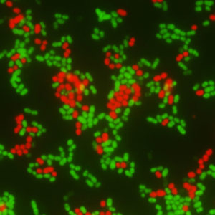
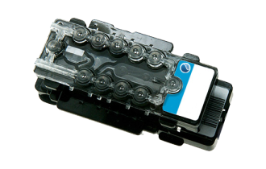
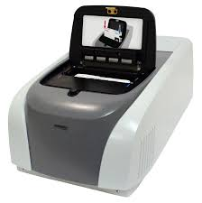
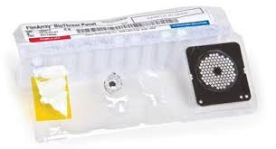
Enterococci
PNA FISH (AdvanDx) + ASP
Significant reduction in 30-day all-cause mortality for E. faecium
Verigene BC-GP (Luminex) + ASP
Reduced hospital LOS and decreased overall hospital costs (-$58,000/patient) but no change in mortality
FilmArray BCID (bioMerieux) VRE + ASP
Decrease in mortality, 30-day readmission rate, ICU LOS, and post-culture LOS, but none were statistically significant
Decreased median cost per hospital stay (-$40,000)
Forrest et al. 2008. Antimicrob Agents Chemother 52: 3558
Sango et al. 2013. J Clin Microbiol 51:4008; MacVane et al. 2016. Infect Diseases 48:732

Slide 19
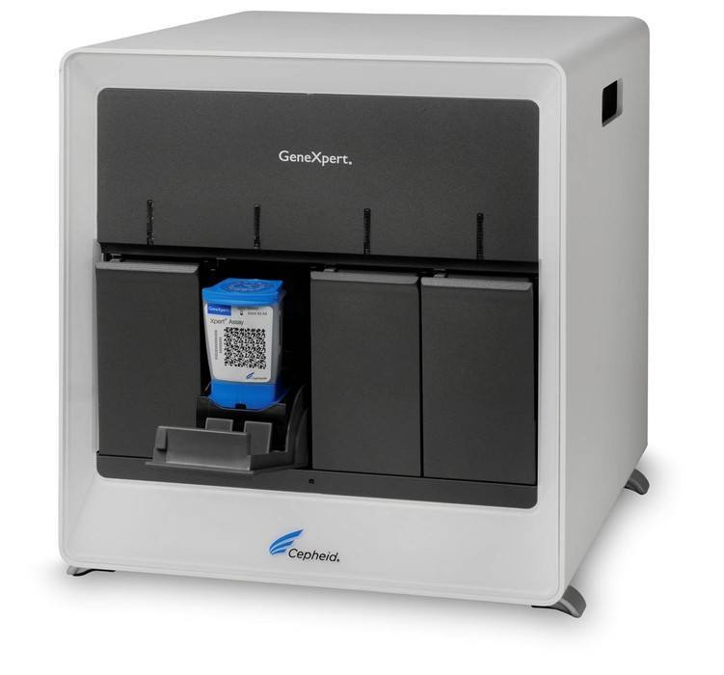
Staphylococci
Xpert MRSA (Cepheid) + ASP
Increased de-escalation of antibiotic therapy
Overall hospital costs decreased by $21,000 per patient
MALDI-TOF MS (Bruker Daltonik) identification of coagulase-negative Staphylococcus spp. + ASP
Decreased vancomycin usage
Significant reduction in 30-day all-cause mortality
Bauer et al. 2010. Clin infect Dis 51:1074; Nagel et al. 2014. J Clin Microbiol 52:2849

Slide 20
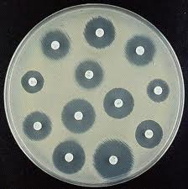
Gram-Negative Bacteria
Direct MALDI-TOF MS (BD) identification and direct susceptibility testing + ASP
Effective therapy started 58 hours earlier
Significant reduction in 30-day all-cause mortality
Verigene BC-GN (Luminex) + ASP
Decreased ICU length of stay
Significant reduction in 30-day all-cause mortality
Perez et al. 2014. J Infect 69:216; Walker et al. 2016. J Clin Microbiol 54:1789

Slide 21
Blood Culture Outcome Studies
Significant patient and economic benefit when analyzing these subsets of pathogens
In reality, the lab will perform testing on all positive blood cultures including…
Blood culture contaminants
Common or expected blood culture pathogens, for which patients are on appropriate antimicrobial therapy
Blood cultures with resistant organisms, for which empiric antimicrobials are not effective

Slide 22
Positive Blood Cultures, All Organisms
MALDI-TOF MS (BD) + ASP (x 2 studies)
Decreased hospital length of stay
Decreased overall hospital costs by $19,000/$2,500 per patient
Significant reduction in 30-day all-cause mortality
FilmArray BCID (bioMerieux) + ASP (x 3 studies)
Increased drug de-escalation
No difference in mortality, readmission, ICU LOS, post-culture LOS or hospital costs
Did not reduce time to antibiotic escalation or de-escalation
No change in hospital LOS or inpatient mortality
Perez et al. 2013. Arch Pathol Lab Med 137:1247; Patel et al. 2017. J Clin Microbiol 55:60-67
MacVane and Nolte 2016. J Clin Microbiol 54: 2455; Tseng et al. 2018. Open Forum Infect Dis 5(12); Shemanski 2019. Open Forum Infect Dis 6(9)

Slide 23
Positive Blood Cultures, All Organisms
Randomized control trial of FilmArray BCID (bioMerieux) +/- ASP
No difference in cost, length of stay, or mortality identified

Slide 24
Organism identification directly from blood

Slide 25
Direct from Blood RDTs
Very little outcome data despite several FDA tests available
T2 Candida Panel + ASP
Decrease in time to appropriate antifungal thearapy
Did not significantly change hospital LOS, ICU LOS, mortality or readmissions rates
Comparison of fungal biomarkers to T2 Candida Panel
Patients positive by T2 Candida Panel had worse clinical outcomes
Patch et al. 2018. J Antimicrob Chemother 73: iv 27-iv30
Munoz et al. 2018. J Antimicrob Chemother 73:iv13-iv19; Munoz et al. 2018. J Antimicrob Chemother 73:iv6-iv12
Notes:
Spanish study showed that compared to B-D-glucan and Candida albicans germ tube antibodies, patients with T2Candida assay did poorly. Continued positivity by T2 occurred in patients with worse outcomes. T2 could be used as a prognostic indicator for those developing complicated candida infections.

Slide 26
Organism identification and rapid susceptibility testing from positive blood culture broth

Slide 27
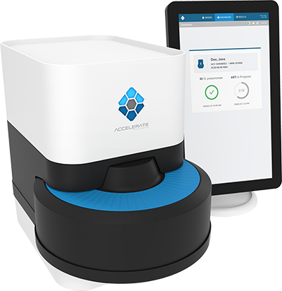
Organism ID and Rapid Susceptibility Testing from Positive Blood Culture Broth
Accelerate Pheno + AST
Reduced time to ID and AST
Reduced time to antimicrobial escalation and de-escalation
No difference antimicrobial consumption, inpatient mortality, LOS or incidence of C. difficile infection
Ehren et al. 2019. Clinical Infectious Diseases

Slide 28
Summary of Blood Culture RDT Outcome Studies
Blood culture RDT are accurate, reduce the turnaround time to results, and identify opportunities for rapid optimization of antimicrobial therapy
Less than 20 outcome studies are available to measure the actual impact of blood culture RDTs on patient care and hospital costs
The majority of studies measuring impact of RDTs on a single organism group identified improvement in patient outcomes and/or cost savings
Impact was less clear when organisms identified from all positive blood cultures were measured
Results were often variable, even when using the same RDT or measuring the same organism group

Slide 29
Why Aren’t There More Outcome Studies?
These studies are very difficult to perform well
Time consuming
Requires great manpower and inter-departmental cooperation
Hospital financial data difficult to obtain
Laboratory
Pharmacy
Hospital
Finance

Slide 30
Why is the impact of blood culture RDTs so variable?

Slide 31
Type of Organisms Included in the Study
Organisms which most frequently require change in antimicrobial therapy
Multi-drug resistant Gram-negative rods
Vancomycin-resistant enterococci
Candida
Methicillin-resistant Staphylococcus aureus (MRSA)
Biggest impact to patient care
Low percentage of overall organisms isolated from BSI

Slide 32
Comparator Method Used for Testing
Large reduction in turnaround time to results
Bigger opportunity to show impact on patient care
It is harder to show the impact of incremental changes
Labs that implement new technology frequently → harder time showing the impact of each new assay

Slide 33
Cost Analysis
There are many costs that go into patient care
Laboratory
Pharmacy
Intensive care unit
Overall cost of hospital care
Costing results depend on how data is gathered and analyzed
Accurate data at the individual patient level is extraordinarily difficult to obtain

Slide 34
Antimicrobial Resistance Rates
Antimicrobial resistance rates differ widely across institutions
Local resistance rates
Pediatric vs. adult vs. geriatric patients
Immunocompromised vs. immunocompetent
Travel and immigration
Other factors affecting baseline health of a population (homelessness, nursing homes, drug use, ect.)

Slide 35
Results Communication
Passive communication
Results reported in medical record
Active communication
Results actively communicated to clinician, pharmacist, infectious diseases physician, or antimicrobial stewardship team
Phone, page, email, electronic alert
Antimicrobial stewardship is the single most important factor impacting antimicrobial escalation and de-escalation

Slide 36
Physician Practices
Opportunity to Optimize Antibiotic Therapy
Antibiotic Therapy Changed
Blood Culture RDT Result
Q. How willing are physicians to change antibiotics based on an RDT result?
A. It depends…

Slide 37
Will Blood Culture RDTs Have an Impact in Your Hospital?
Hospital A
Low rates of resistance; large transplant population
Empiric therapy for GNR bacteremia is a carbapenem
Unlikely to de-escalate before full phenotypic susceptibility testing is complete
Hospital B
Low rates of resistance, few immunocompromised patients
Empiric therapy for GNR bacteremia is a 3rd generation cephalosporin
Very likely to escalate therapy quickly based on RDT

Slide 38
Impact of Blood Culture RDTs
Studies have shown escalation > > > > de-escalation
Both in willingness to change/add therapy and in time to antimicrobial change
Using the same blood culture RDT
Hospital B has the potential to show a HUGE impact on patient care and hospital costs
Hospital A will likely show no benefit

Slide 39
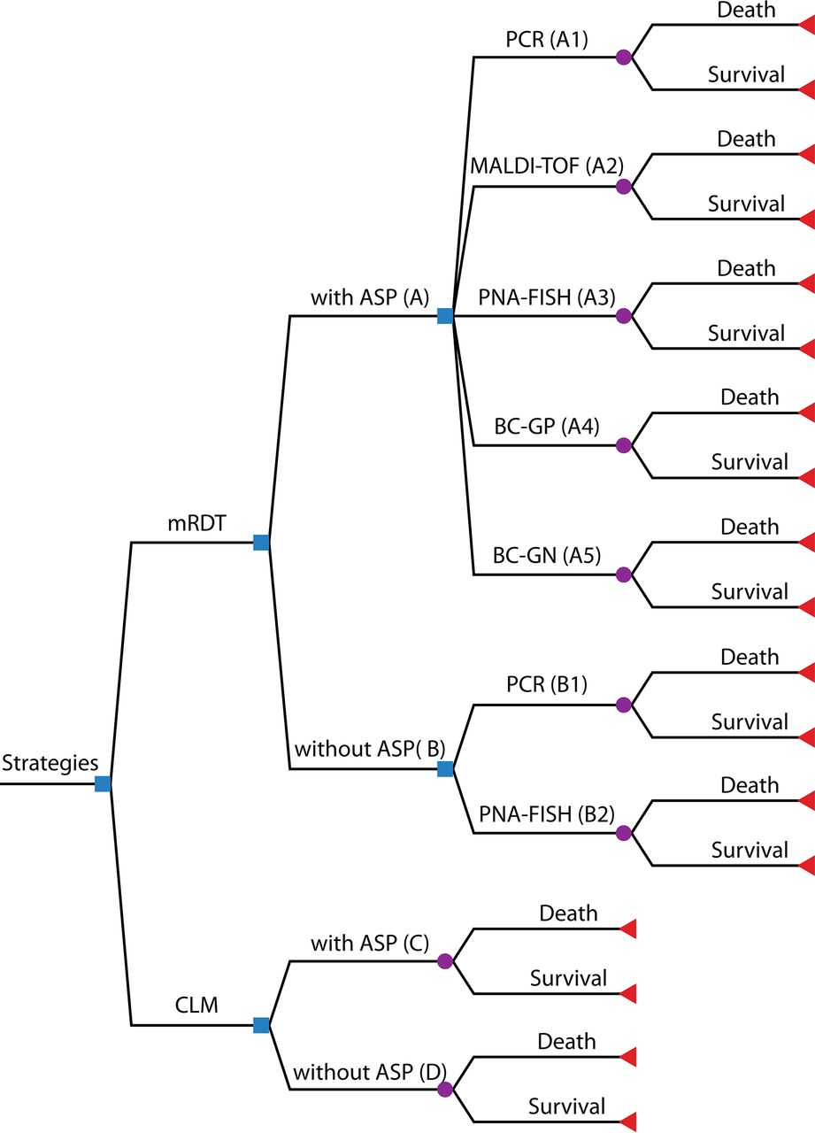
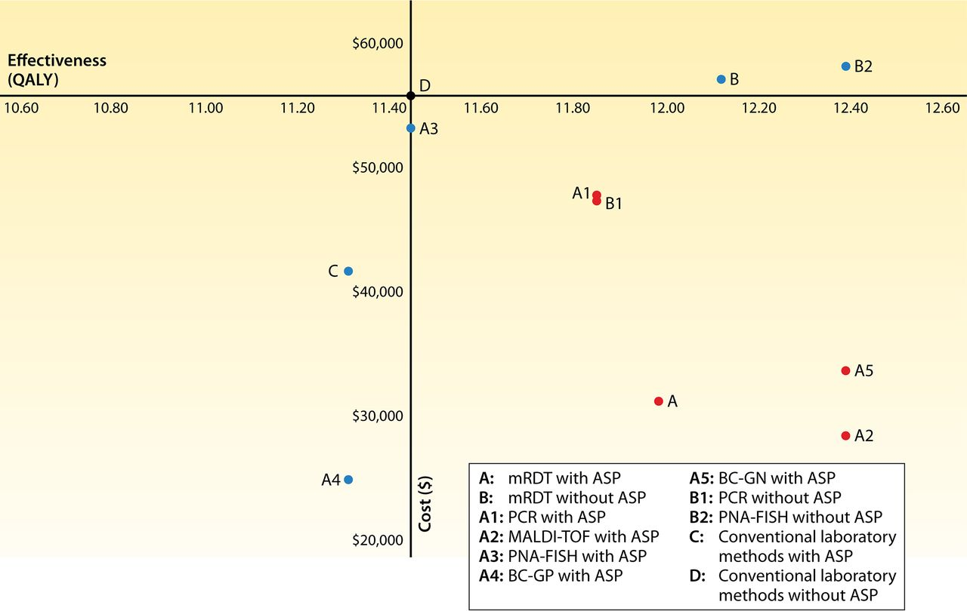
Cost-Effectiveness Modeling of Blood Culture RDTs
Average Cost of a Strategy
Conventional Methods WITHOUT ASP
Average Effectiveness of a Strategy
Pliakos et al. 2018. Clinical microbiology reviews 31.3: e00095-17
Notes:
Meta-analysis of available data
Lacking data for comparison due to what is available in the literature; caution as data is based on few studies
Newer methods are not represented
Red = cost-effective strategies
QALY=quality of life years

Slide 40
Take Home Points
Blood culture RDTs decrease the turnaround time for results, but data supporting improved patient outcomes and reduced hospital costs are variable
Although outcome studies are very difficult to perform, more are needed
These studies help justify laboratory implementation of current RDTs and promote development of new rapid diagnostic testing

Slide 41
Make the Case for Blood Culture RDTs
Reduced healthcare costs
COST
Improved patient outcomes
Easy to use
Rapid turnaround time
Notes:
We need to justify cost to ourselves and hospital administration

Slide 42
Acknowledgements
Dr. Mike Dunne for his mentorship
ISM Pasteur Award Organizing Committee
Colleagues and microbiology technologists at NorthShore University HealthSystem

