Slide 1
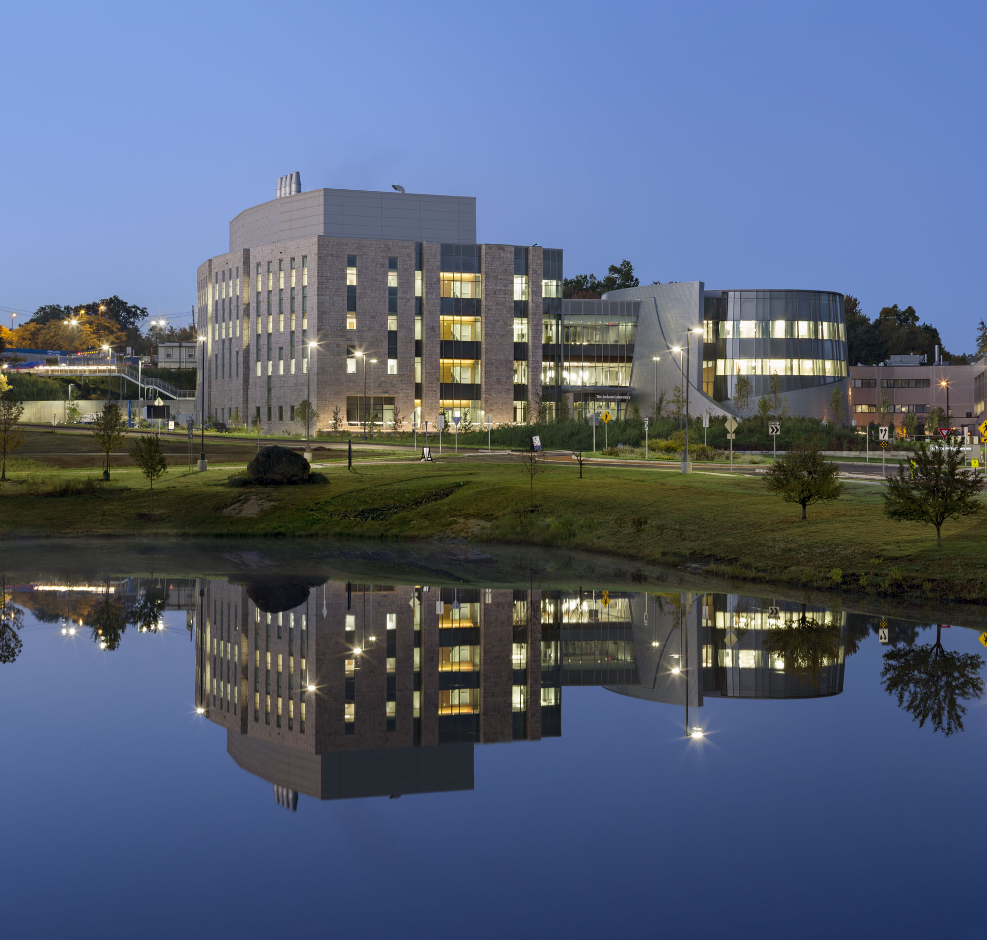
The Medical Microbiome: Insurmountable Opportunities
George Weinstock
Jackson Laboratory for Genomic Medicine
Farmington, CT
Illinois Society for Microbiology Annual Meeting
Chicago
November 13, 2019

Slide 2

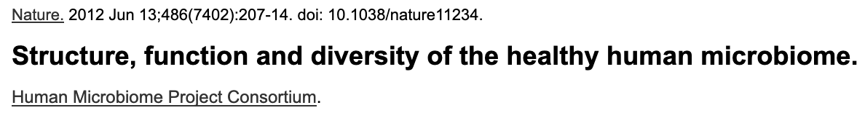
The Human Microbiome Project ConsortiumCurtis Huttenhower1,2*,DirkGevers2*, Rob Knight3,4, Sahar Abubucker5, Jonathan H.Badger6, Asif T. Chinwalla5,Heather H.Creasy7,AshleeM.Earl2,MichaelG.FitzGerald2,Robert S. Fulton5,MichelleG.Giglio7, Kymberlie Hallsworth-Pepin5, Elizabeth A.Lobos5, Ramana Madupu6, Vincent Magrini5,JohnC.Martin5, Makedonka Mitreva5,Donna M. Muzny8, Erica J. Sodergren5, James Versalovic9,10, Aye M. Wollam5,KimC.Worley8,JenniferR.Wortman7,SarahK.Young2,QiandongZeng2,KjerstiM.Aagaard11,Olukemi O. Abolude7, Emma Allen-Vercoe12,EricJ.Alm13,2, Lucia Alvarado2,GaryL.Andersen14, Scott Anderson2, Elizabeth Appelbaum5,HarindraM.Arachchi2,GaryArmitage15, Cesar A. Arze7, Tulin Ayvaz16, CarlC.Baker17,LisaBegg18, TsegahiwotBelachew19, Veena Bhonagiri5, Monika Bihan6, Martin J. Blaser20, TobyBloom2, VivienBonazzi21, J.PaulBrooks22,23, Gregory A. Buck23,24, Christian J. Buhay8,DanaA.Busam6, Joseph L. Campbell21,19, Shane R. Canon25, Brandi L. Cantarel7, Patrick S. G.Chain26,27, I-Min A. Chen28, Lei Chen5,ShailaChhibba21, Ken Chu28,DawnM.Ciulla2,Jose C. Clemente3, Sandra W. Clifton5,SeanConlan79, Jonathan Crabtree7,MaryA.Cutting29, Noam J. Davidovics7, Catherine C. Davis30, Todd Z. DeSantis31, CarolynDeal19, Kimberley D. Delehaunty5, Floyd E. Dewhirst32,33, Elena Deych34, Yan Ding8,David J. Dooling5, Shannon P. Dugan8, Wm Michael Dunne35,36, A. Scott Durkin6,Robert C. Edgar37, RachelL.Erlich2, Candace N. Farmer5,RuthM.Farrell38, KarolineFaust39,40, Michael Feldgarden2,VictorM.Felix7, Sheila Fisher2, Anthony A. Fodor41,Larry J. Forney42, Leslie Foster6, Valentina Di Francesco19, Jonathan Friedman43,Dennis C. Friedrich2, Catrina C. Fronick5, Lucinda L. Fulton5,HongyuGao5, NathaliaGarcia44, Georgia Giannoukos2, Christina Giblin19, Maria Y. Giovanni19,JonathanM.Goldberg2, JohannesGoll6, AntonioGonzalez45,Allison Griggs2,SharvariGujja2,SusanKinder Haake46, Brian J. Haas2, Holli A. Hamilton29, Emily L. Harris29,TheresaA.Hepburn2, Brandi Herter5, Diane E. Hoffmann47, Michael E. Holder8, Clinton Howarth2,Katherine H. Huang2, Susan M. Huse48, Jacques Izard32,33, Janet K. Jansson49,Huaiyang Jiang8, Catherine Jordan7, Vandita Joshi8, James A. Katancik50, Wendy A.Keitel16, Scott T. Kelley51, Cristyn Kells2,NicholasB.King52, Dan Knights45, HeidiH.Kong53, OmryKoren54,SergeyKoren55, Karthik C. Kota5, Christie L. Kovar8,NikosC.Kyrpides27, Patricio S. La Rosa34,SandraL.Lee8, Katherine P. Lemon32,56,NiallLennon2, CecilM.Lewis57, LoraLewis8,RuthE.Ley54,KelvinLi6, Konstantinos Liolios27,Bo Liu55, Yue Liu8, Chien-Chi Lo26, Catherine A. Lozupone3,R.DwayneLunsford29,Tessa Madden58, Anup A. Mahurkar7, Peter J. Mannon59, Elaine R. Mardis5, Victor M.Markowitz27,28, Konstantinos Mavromatis27, Jamison M. McCorrison6,DanielMcDonald3, Jean McEwen21, Amy L. McGuire60, Pamela McInnes29, Teena Mehta2,Kathie A. Mihindukulasuriya5, Jason R.Miller6, Patrick J. Minx5, Irene Newsham8,ChadNusbaum2, Michelle O’Laughlin5,JoshuaOrvis7, Ioanna Pagani27,KrishnaPalaniappan28,ShitalM.Patel61, Matthew Pearson2,JanePeterson21, Mircea Podar62,Craig Pohl5, Katherine S. Pollard63,64,65, Mihai Pop55,66, Margaret E. Priest2,LitaM.Proctor21, Xiang Qin8, Jeroen Raes39,40, Jacques Ravel7, Jeffrey G. Reid8,MinaRho67,Rosamond Rhodes68, Kevin P. Riehle69, Maria C. Rivera23,24,BeltranRodriguez-Mueller51, Yu-Hui Rogers6, Matthew C. Ross16, Carsten Russ2,RaviK.Sanka6, Pamela Sankar70, J. Fah Sathirapongsasuti1, Jeffery A. Schloss21, Patrick D.Schloss71,ThomasM.Schmidt72, Matthew Scholz26, Lynn Schriml7, Alyxandria M.Schubert71, NicolaSegata1, JuliaA.Segre79, WilliamD.Shannon34, RichardR.Sharp38, ThomasJ.Sharpton63, NarmadaShenoy2,NiharU.Sheth23,GinaA.Simone73,IndreshSingh6, Christopher S. Smillie43, Jack D. Sobel74,DanielD.Sommer55, Paul Spicer57, GrangerG.Sutton6, SeanM.Sykes2, DianaG.Tabbaa2,MathangiThiagarajan6,ChadM.Tomlinson5,ManolitoTorralba6,ToddJ.Treangen75, Rebecca M. Truty63, Tatiana A.Vishnivetskaya62, Jason Walker5, Lu Wang21, Zhengyuan Wang5, Doyle V. Ward2,Wesley Warren5, Mark A. Watson35, Christopher Wellington21, Kris A. Wetterstrand21,James R. White7, Katarzyna Wilczek-Boney8, YuanQing Wu8, Kristine M. Wylie5,ToddWylie5, Chandri Yandava2, Liang Ye5,YuzhenYe67, Shibu Yooseph76,BonnieP.Youmans16, Lan Zhang8, Yanjiao Zhou5, Yiming Zhu8,LaurieZoloth77,JeremyD.Zucker2, Bruce W. Birren2, Richard A. Gibbs8, Sarah K. Highlander8,16,BarbaraA.Methe ́6, Karen E. Nelson6, Joseph F. Petrosino8,78,16, George M. Weinstock5,RichardK.Wilson5&OwenWhite7

Slide 3
Clinical Microbiome Projects
Recent & Ongoing
Aging (Indiana Univ. Med. Sch., Univ. Arizona Med Sch.)
HIV-Lung Microbiome (Indiana Univ)
Cocaine addiction
Fungal - respiratory (Harvard)
Vitamin D - respiratory (Harvard)
Cancer (UCHC)
Parkinson’s Disease
Neonatal-breast milk (CCMC, Harvard/BC)
Fecal transplants and C. difficile (Harvard)
Host genotype and microbiome
Acne, Psoriasis, other skin diseases
Bariatric surgery (Hartford Hospital)
Athlete microbiomes
Sickle Cell disease
Diabetes (Stanford)
Pneumococcus vaccine (Bangladesh, Gambia)
Bacterial vaginosis (Wash U)
etc

Slide 4
Clinical Microbiome Projects
Recent & Ongoing
Aging (Indiana Univ. Med. Sch., Univ. Arizona Med Sch.)
HIV-Lung Microbiome (Indiana Univ)
Cocaine addiction
Fungal - respiratory (Harvard)
Vitamin D - respiratory (Harvard)
Cancer (UCHC)
Parkinson’s Disease
Neonatal-breast milk (CCMC, Harvard/BC)
Fecal transplants and C. difficile (Harvard)
Host genotype and microbiome
Acne, Psoriasis, other skin diseases
Bariatric surgery (Hartford Hospital)
Athlete microbiomes
Sickle Cell disease
Diabetes (Stanford)
Pneumococcus vaccine (Bangladesh, Gambia)
Bacterial vaginosis (Wash U)
etc
Some day there will be microbial diagnostics, treatments for many of these.

Slide 5
Microbiome Analysis
Subject Cohorts e.g. Case/Control
16S rRNA Sequence Data
Shotgun or RNA Sequence Data
Metabolomic Data
Taxonomic Data
Gene/Pathway Data
Discriminating Taxa
Discriminating Genes/Pathways
Causal or Correlation?
Mechanisms
Applications

Slide 6
Microbiome Analysis
Subject Cohorts e.g. Case/Control
16S rRNA Sequence Data
Shotgun or RNA Sequence Data
Metabolomic Data
Taxonomic Data
Gene/Pathway Data
Statistics, data mining
Discriminating Taxa
Discriminating Genes/Pathways
FMT
culturomics
Animal models, clinical tests
Causal or Correlation?
Mechanisms
Applications

Slide 7
Microbiome Analysis
Subject Cohorts e.g. Case/Control
16S rRNA Sequence Data
Shotgun or RNA Sequence Data
Metabolomic Data
Taxonomic Data
Gene/Pathway Data
Statistics, data mining
Discriminating Taxa
Discriminating Genes/Pathways
FMT
culturomics
Animal models, clinical tests
Causal or Correlation?
Mechanisms
Applications

Slide 8
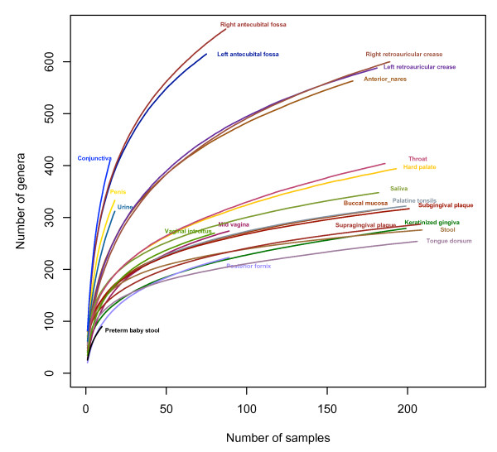
Accumulation curves 22 body habitats
100s of “genera”
1000s of “species”
Biogeography of the ecosystems of the healthy human body. Zhou et al. Genome Biol 14, R1 (2013)
Notes:
Each line represents the accumulative richness from all subjects. All the reads were included in the analysis to have a full view of the genera revealed by the HMP and other datasets. At the genus level, oral, vaginal, and stool habitats become asymptotically flat at the current sampling depth and sampling efforts. More subjects are needed to reach the saturation for skin and skin-associated habitats.

Slide 9
More dimensions
Bacteria
Viruses (phages and human)
Eukaryotic microbes
Host data integration
Host genetics
Microbial variation (strains)
Environmental effects (diet)
etc

Slide 10

I am confronted with insurmountable opportunity

Slide 11
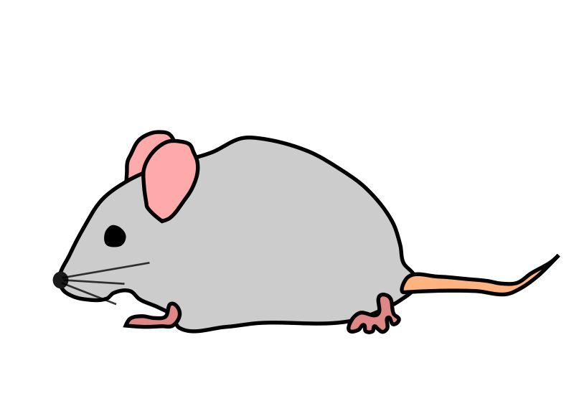
C. difficile mouse model
Resistant
Sensitive
Yee-Shiuan Chen
David Haslam
Yanjiao Zhou
Clostridium difficile
Fecal transplant
Compare Microbiomes
Identify Differences
Test

Slide 12
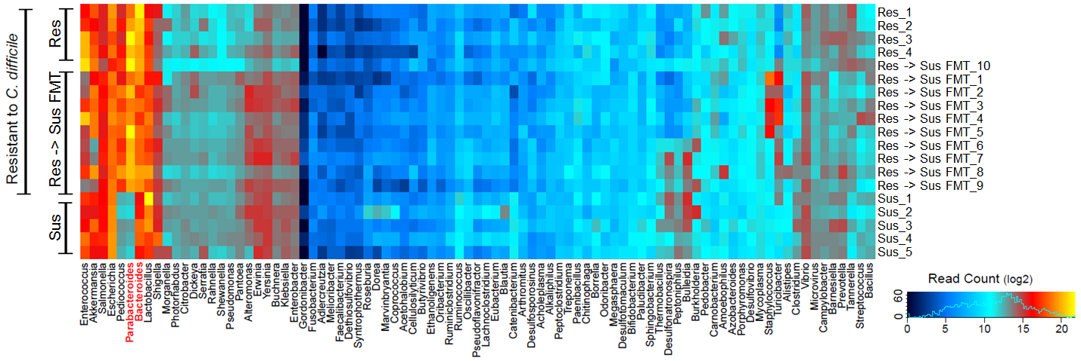
Identification of Protective Species
Notes:
Fig. 1. Identification of protective bacterial species against CDI. a) Protective effect of crude-FMT after antibiotics treatment. CDI-susceptible mice got crude FMT from CDI-resistant mice following antibiotic treatment. Control mice (No-FMT) received sterile drinking water. Both groups of animals were then infected with C. difficile and observed for disease symptoms (n≥8 in all groups). b) C. difficile burden: DNA was extracted from fecal pellets of mice from different groups at various times after CDI. C. difficile burden was measured by qPCR. *No mice survived past Day2. c) Heat map showing differential bacterial abundance between different groups. Fecal DNA was extracted and species abundance was determined by 454 sequencing of the 16S gene segment from resistant, susceptible and susceptible-FMT mice. Multiple Fisher’s exact test was used to find statistically significant differences in species abundance. d-e). Whole genome analysis revealed that Bacteroides and Parabacteroides species were enriched following Crude-FMT and their presence correlated with survival after CDI. f) Similar pattern was observed in human samples. Stool samples were collected from patients with CDI or other causes of hospital-acquired diarrhea. 16S rRNA sequencing was performed and species abundance determined. Parabacteroides species were negatively correlated with CDI. Patients with the highest C. difficile abundance (% reads > 1; High) had the lowest Parabacteroides abundance. CDI patients with low C. difficile burden (% reads < 1; Low) had intermediate levels of Parabacteroides, while C. difficile negative (Control) had the highest Parabacteroides abundance. g) Mixture of four newly identified protective bacterial species (B. uniformis, B. ovatus, P. merdae and P. distasonis) in equal proportion was gavaged for 3 days and observed for disease symptoms (n≥30 in all groups). Positive and negative control mice received crude-FMT and No-FMT respectively. h) Feces were collected from all groups, DNA was extracted and C. difficile burden was measured by qPCR

Slide 13
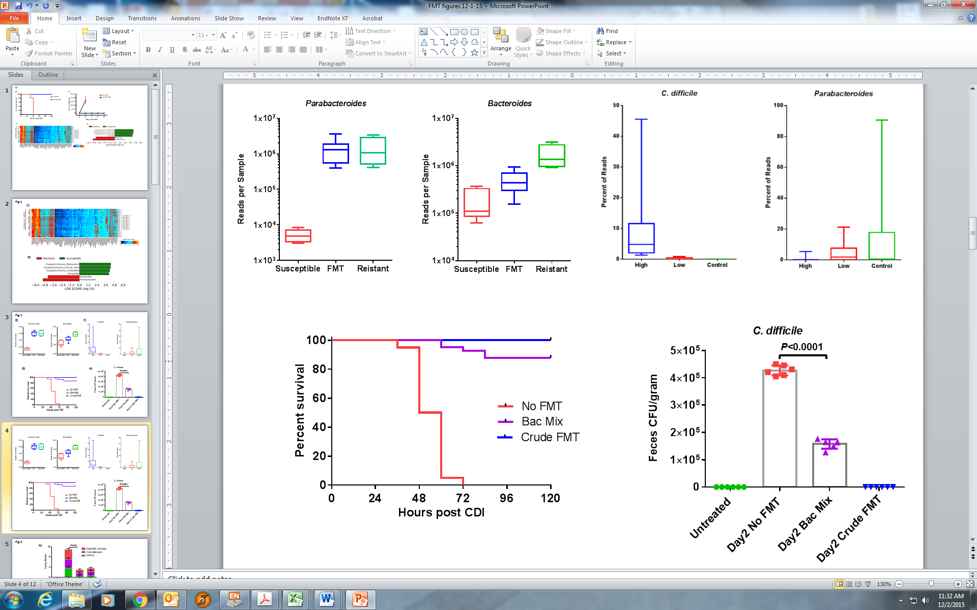
C. difficile mouse model
Treatment by fecal microbiota transplant (FMT) or a mix of 4 gut bacteria

Slide 14
Many, many methods to mine data
Metric: Prevalence or abundance
Density/violin plots
Random forest
PCoA
NMDS
Constrained ordination
Pearson correlation
Various analysis of variance
General Linear Model
LASSO
etc

Slide 15
Genus Oscillibacter decreased abundance on cholic acid diet
AIN diet (6 weeks)
then either
High protein diet
or
High fat cholic acid diet
(17 and 24 weeks)
Genus Akkermansia increased abundance on cholic acid diet
Genus Ruminococcus no effect of diet

Slide 16
Genera Abundance: Young vs. Old
6 month
18 month
Catabacter
Clostridium XIVa
Density plot and violin plot show the significant shift of microbial abundance from young to old.

Slide 17
Significant OTUs: Aging effects in Female and Male
OTUs | Female | Male | Both
Increase from 6m to 18 m | ↑ OTU_147_unclassified_Lachnospiraceae**** | ↑ OTU_84_Anaerovorax***
 | ↑ OTU_53_unclassified_Lachnospiraceae** | ↑ OTU_9_unclassified_Porphyromonadaceae**** | ↑ OTU_77_unclassified_Lachnospiraceae (F****, M*)
 | ↑ OTU_166_unclassified_Lachnospiraceae**** | ↑ OTU_51_Eisenbergiella** | ↑ OTU_187_unclassified_Lachnospiraceae (F****, M**)
 | ↑ OTU_64_unclassified_Lachnospiraceae** |  | ↑ OTU_122_unclassified_Lachnospiraceae**
 | ↑ OTU_28_unclassified_Lachnospiraceae**** |  | ↑ OTU_52_Eisenbergiella*
 | ↑ OTU_106_Clostridium_XlVa**** |  | ↑ OTU_44_Eisenbergiella**
 | ↑ OTU_191_Clostridium_XlVa* |  | ↑ OTU_132_Coprococcus (F****, M**)
 | ↑ OTU_112_Clostridium_XlVa*** |  | ↑ OTU_168_Fusicatenibacter (F**, M***)
 | ↑ OTU_74_Clostridium_XlVa*
 | ↑ OTU_164_Clostridium_XlVb**
 | ↑ OTU_102_Lachnospiracea_incertae_sedis*
 | ↑ OTU_88_Acetatifactor**
Decrease from 6m to 18m | ↓ OTU_110_Pseudoflavonifractor** | ↓ OTU_36_unclassified_Lachnospiraceae** | ↓ OTU_103_unclassified_Lachnospiraceae*
 | ↓ OTU_24_unclassified_Porphyromonadaceae*** | ↓ OTU_113_unclassified_Lachnospiraceae**** | ↓ OTU_43_unclassified_Porphyromonadaceae (F****, M***)
 | ↓ OTU_7_unclassified_Porphyromonadaceae**** | ↓ OTU_124_Intestinimonas** | ↓ OTU_47_unclassified_Porphyromonadaceae (F*, M**)
 |  | ↓ OTU_46_unclassified_Ruminococcaceae**** | ↓ OTU_18_unclassified_Porphyromonadaceae (F**, M*)
 |  | ↓ OTU_2_Anaeroplasma**** | ↓ OTU_78_unclassified_Clostridiales****
 |  | ↓ OTU_169_Pseudoflavonifractor**** | ↓ OTU_26_unclassified_Clostridiales****
 |  |  | ↓ OTU_98_unclassified_Ruminococcaceae (F*, M*)
 |  |  | ↓ OTU_10_Eisenbergiella (F****, M**)
 |  |  | ↓ OTU_71_Oscillibacter (F*, M**)
 |  |  | ↓ OTU_38_Barnesiella (F**, M*)
 |  |  | ↓ OTU_8_Barnesiella (F**, M*)

Slide 18
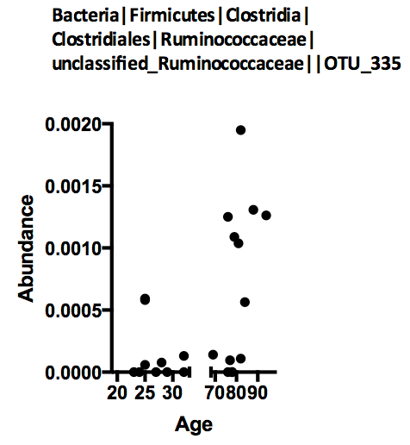
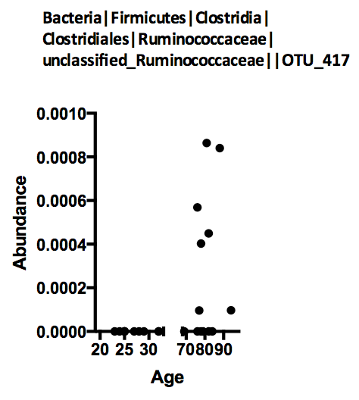
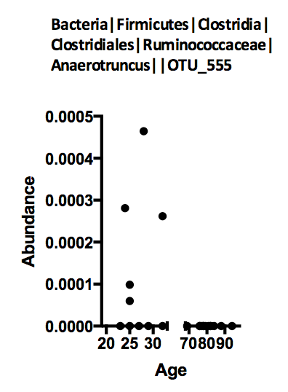
Human Microbiome Age Differences in Gut Prevalence
20-35 YO
70-90 YO
Bacteria mainly in young
Bacteria mainly in elderly

Slide 19
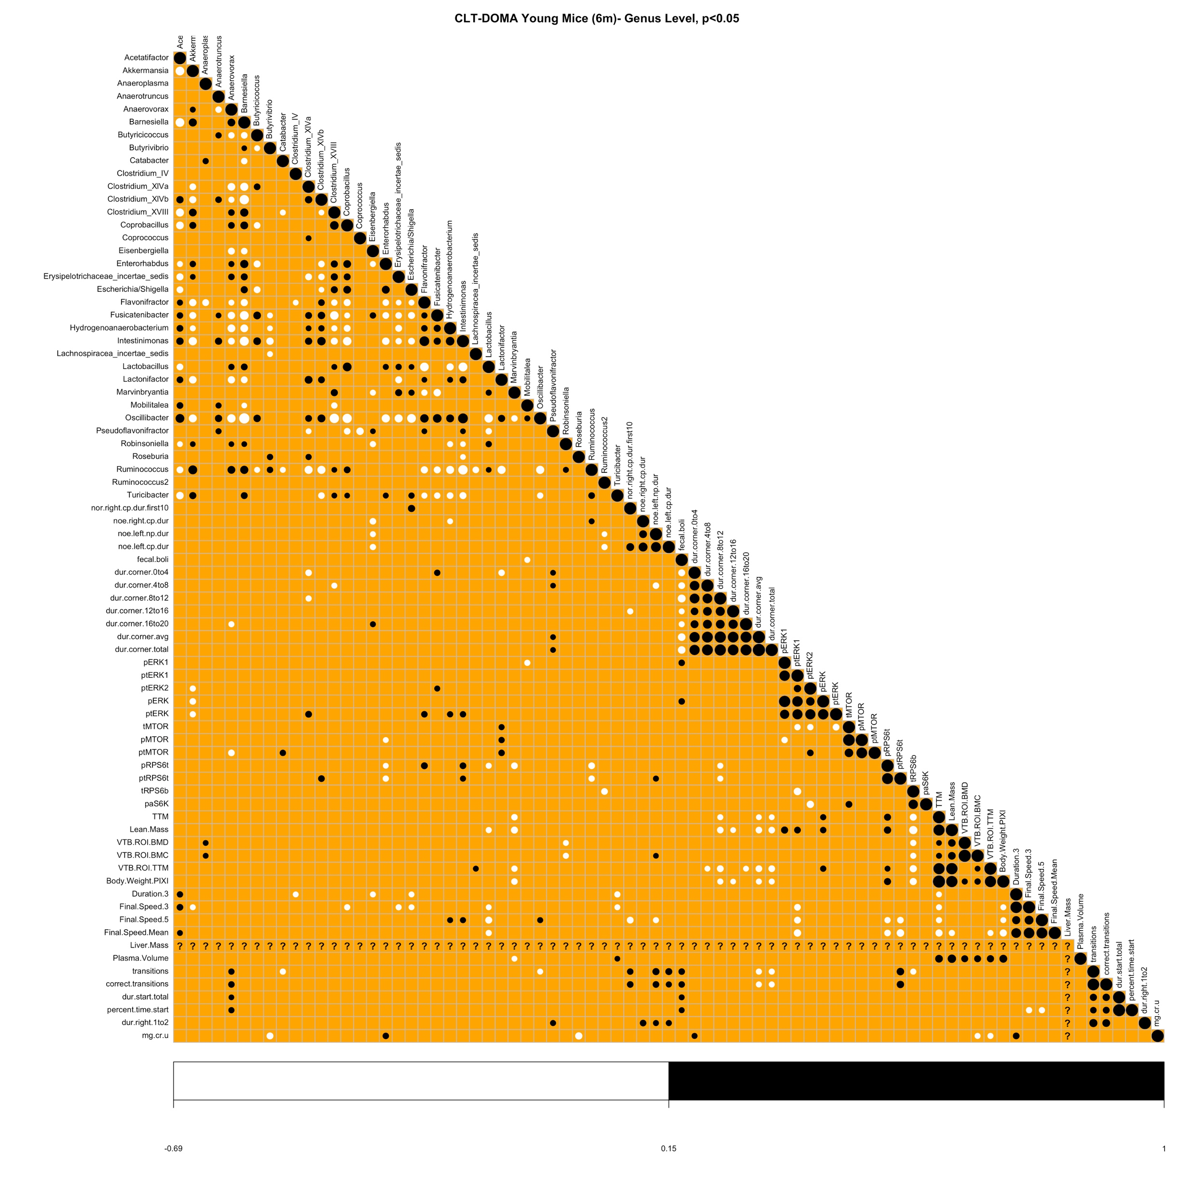
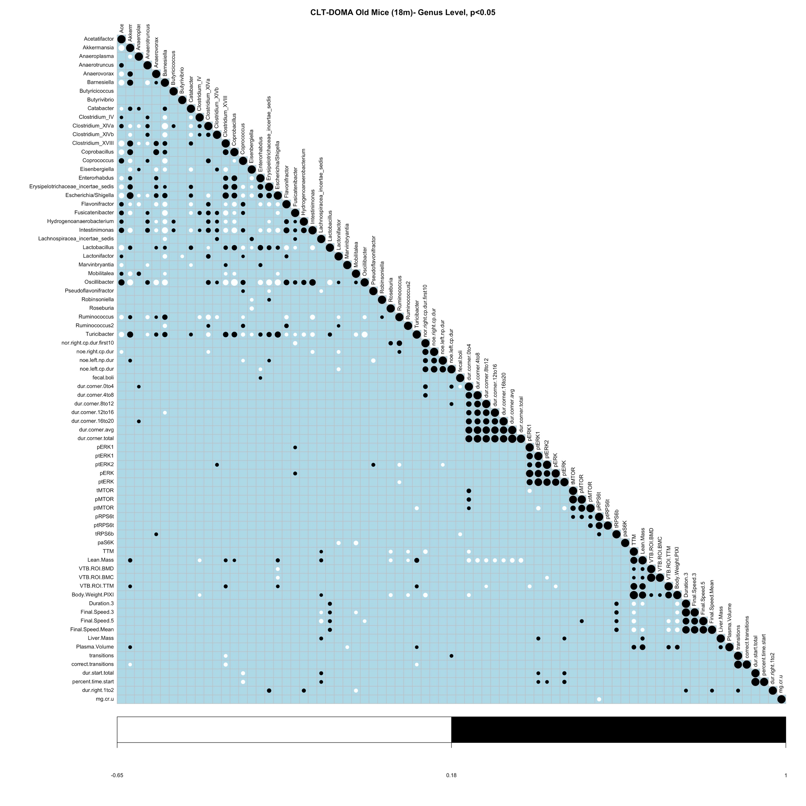
Genus Level Spearman Correlation: Young vs. Old

Slide 20
GLM
Phenotype i ~ Sex + Genus i
FDR<0.1
✓
✓
✓
✓
✓
✓
✓
✓
✓
✓
✓
✓
Novel_obj
Open.field
Mtor
Pixi
Rotarod
Sac
Tmaze
Urine
Novel_obj
Open.field
Mtor
Pixi
Rotarod
Sac
Tmaze
Urine

Slide 21
LASSO
nPhenotype i+ Sex ~ nGenus i
Young Mice (6 months) 77 samples, 20 variables
Old Mice (18 months) 101 samples, 20 variables
Lactonifactor
Top 10 genera affect on phenotypes
Coprobacillus
Top 10 genera affect on phenotypes
Lactonifactor
Erysipelotrichaceae_incertae_sedis
Anaeroplasma
Coprobacillus
Akkermansia
Robinsoniella
Ruminococcus2
Lachnospiracea_incertae_sedis
Turicibacter
Butyrivibrio
Clostridium_XVIII
Coprobacillus
Clostridium_XVIII
Butyricicoccus
Lactonifactor
Escherichia.Shigella
Robinsoniella
Anaerovorax
Pseudoflavonifractor
Lachnospiracea_incertae_sedis
Coprococcus
Butyricicoccus
Lactonifactor
Escherichia.Shigella
Erysipelotrichaceae_incertae_sedis
[1] "Acetatifactor"
[2] "Akkermansia"
[3] "Anaeroplasma"
[4] "Anaerotruncus"
[5] "Anaerovorax"
[6] "Barnesiella"
[7] "Butyricicoccus"
[8] "Butyrivibrio"
[9] "Catabacter"
[10] "Clostridium_IV"
[11] "Clostridium_XlVa"
[12] "Clostridium_XlVb"
[13] "Clostridium_XVIII"
[14] "Coprobacillus"
[15] "Coprococcus"
[16] "Eisenbergiella"
[17] "Enterorhabdus"
[18] " Erysipelotrichaceae_incertae_sedis"
[19] "Escherichia.Shigella"
[20] "Flavonifractor"
[21] "Fusicatenibacter"
[22] "Hydrogenoanaerobacterium"
[23] "Intestinimonas"
[24] "Lachnospiracea_incertae_sedis"
[25] "Lactobacillus"
[26] "Lactonifactor"
[27] "Marvinbryantia"
[28] "Mobilitalea"
[29] "Oscillibacter"
[30] "Pseudoflavonifractor"
[31] "Robinsoniella"
[32] "Roseburia"
[33] "Ruminococcus"
[34] "Ruminococcus2"
[35] "Turicibacter"
Akkermansia
Robinsoniella

Slide 22
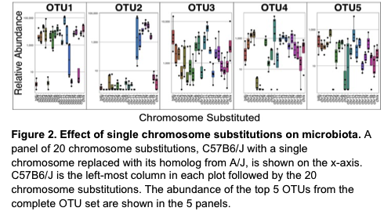
Host genetic control of the microbiome in mouse chromosome substitution strains
Johnson, Nadeau, and Weinstock, unpublished

Slide 23
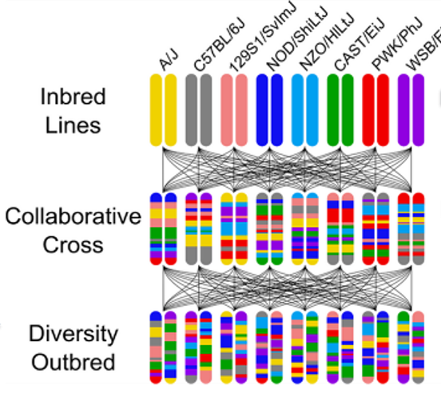
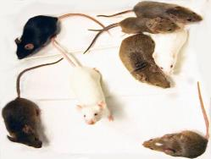
Collaborative Cross (CC) and Diversity Outbred (DO) mice

Slide 24
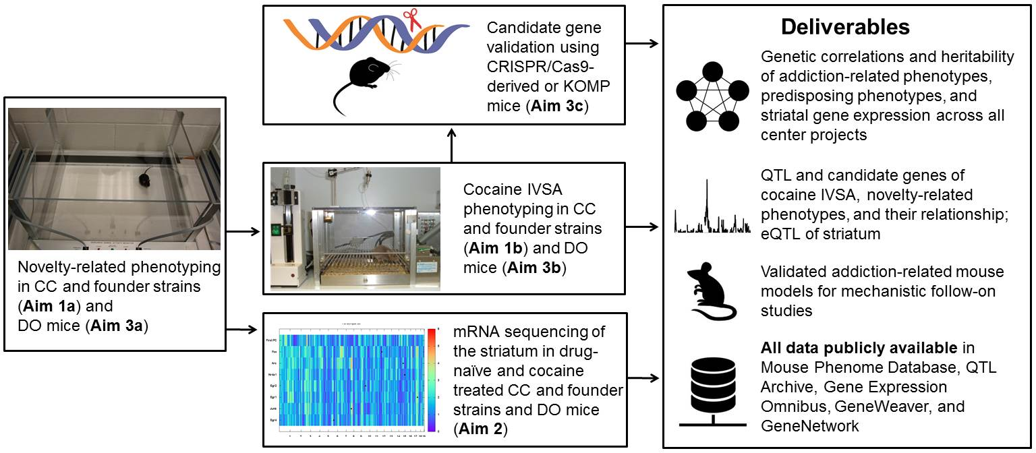
Using DO mice
Genotyping
Phenotype
Gut Microbiome

Slide 25
Using DO mice
Validation
Genotyping
Phenotype
Gut Microbiome

Slide 26
Host genetic control of microbiome

Slide 27
Location of OTU QTLs Mapped for All Weeks

Slide 28
Location of Genus QTLs Mapped for All Weeks

Slide 29

Behavioral sensitization protocol
DAY | 1 | 2 | 3 | 4 | 5 | 6 | 7 | 8 | 9 | 10 | 11 | 12 | 19
Cocaine Group | Sal | Sal | COC | No Testing | COC | No Testing | COC | No Testing | COC | No Testing | COC | Sal | COC
SHAM Group | Sal | Sal | Sal |  | Sal |  | Sal |  | Sal |  | Sal | Sal | Sal
 | Test | Test | Test |  | Test |  | Test |  | Test |  | Test | Test | Test
COC dose =10 mg/kg
Expression (SENSX)
Initial Sensitization Response (ISR)
Cocaine
Sensitization (CSENS)
Habituation/ Baseline (BLB)
Initial Sensitivity (ALRC)
Conditioned Activation (CONACT)
Novelty (NILA)
Adapted from
Phillips et al. 2010, Neuromethods
and Kumar et al. 2013, Science

Slide 30
Microbiome Composition: Coprococcus
CCOO4 /TauUncJ
CCO41/TauUncJ
Higher Coprococcus abundance in CCOO4 than in CCO41
Inverse trends of Coprococcus after Cocaine or Saline exposure
  Cocaine: decrease Coprococcus in both CCOO4 and CCO41
  Saline: increase Coprococcus in both strains.

Slide 31
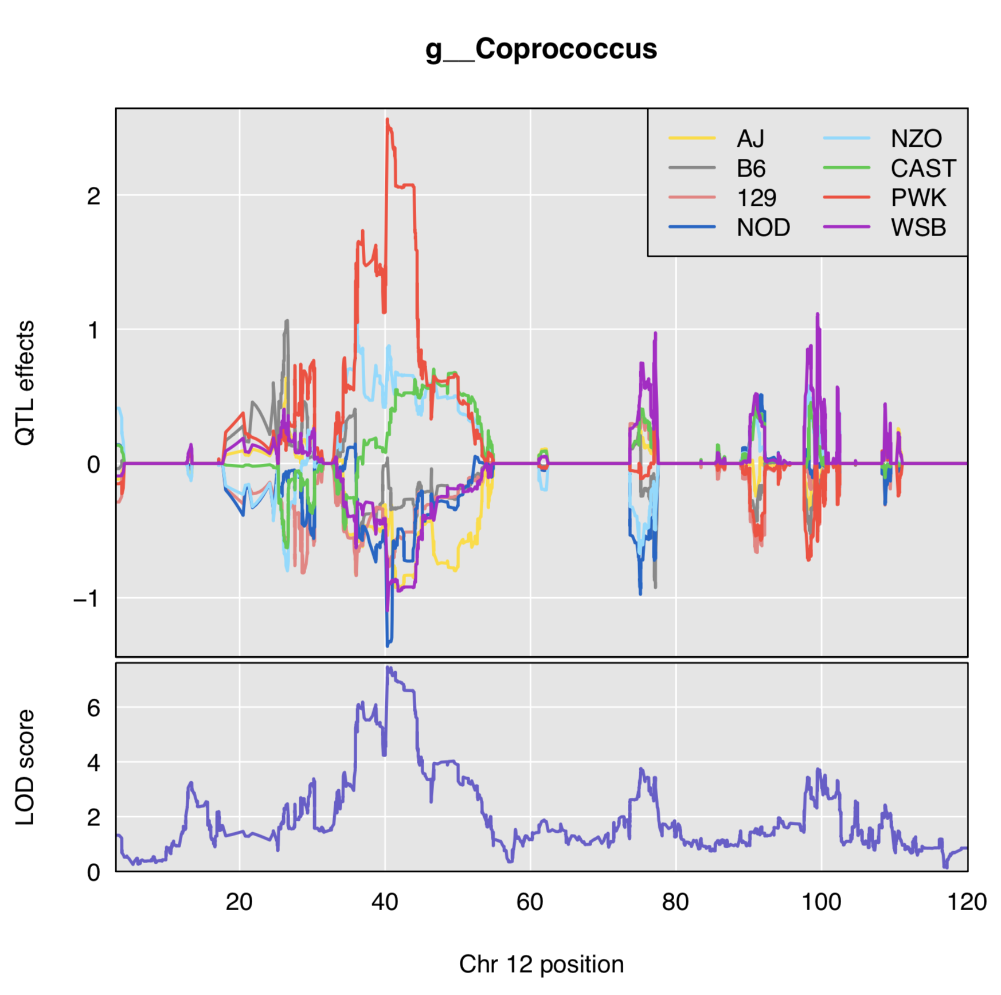
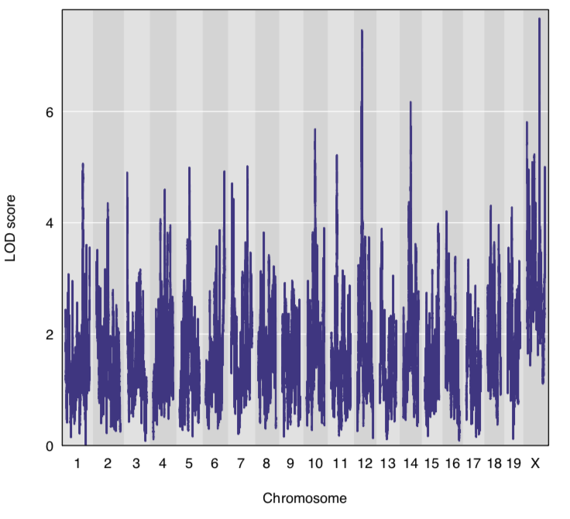
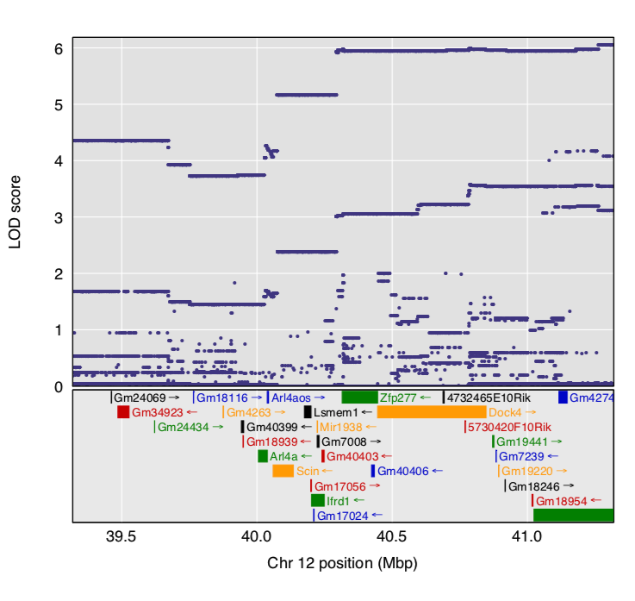
Coprococcus QTL
Dock4

Slide 32
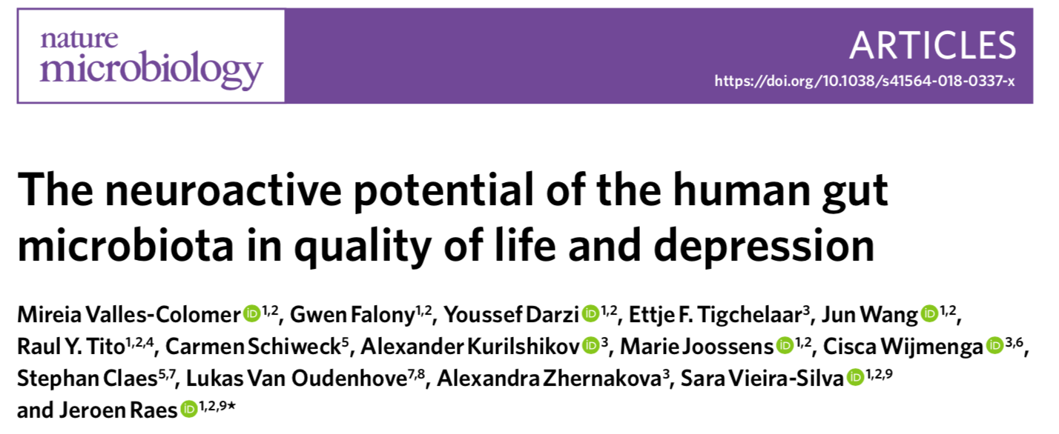
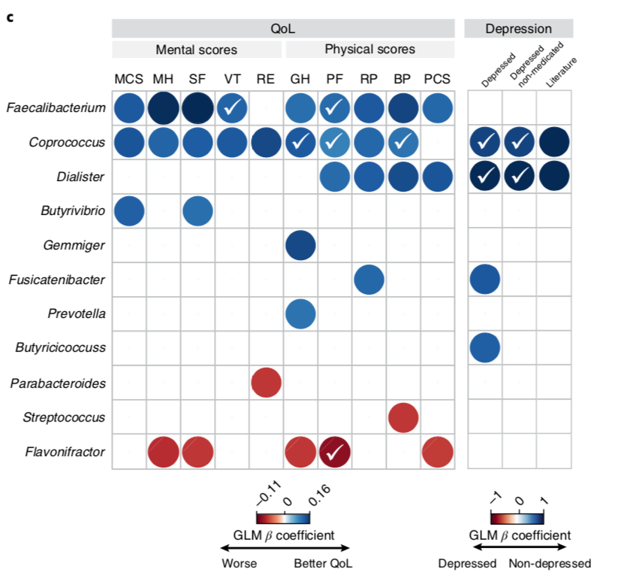
Coprococcus affects human mental health

Slide 33
Gut-Brain-Microbiome Axis: Fun Facts
Gut-Brain Axis: enteric nervous system (second brain), vagus nerve.
Most microbes in the body are in the gut. These directly stimulate the ENS and vagus nerve.
Bacteria produce neurotransmitters like acetylcholine, GABA, norepinephrine, dopamine, serotonin; neurotoxic metabolites like lactic acid, ammonia.
Gut produces 90% of serotonin in the body.
Bacterial metabolites get into the circulation, can pass the blood-brain barrier.
Shown to influence sleep, stress, memory, cognition, mood, alcoholism, CFS, fibromyalgia, restless leg syndrome, Parkinson’s disease, Alzheimer’s disease, autism, multiple sclerosis, and more.

Slide 34
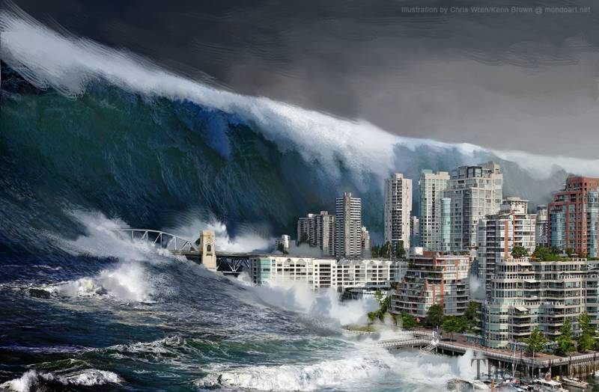


The coming Tsunami of “Taxa of Interest”
MS/EAE mouse model:
Lactobacillaceae, Bacteroidaceae, and Prevotellaceae families
Ellagitannin metabolism
Coriobacteriaceae
Serotonin induction
Turicibacter sanguinis
Can’t just do a targeted qPCR on one taxon.
Need to sequence so you can see all the taxa.
Expensive, laborious

Slide 35
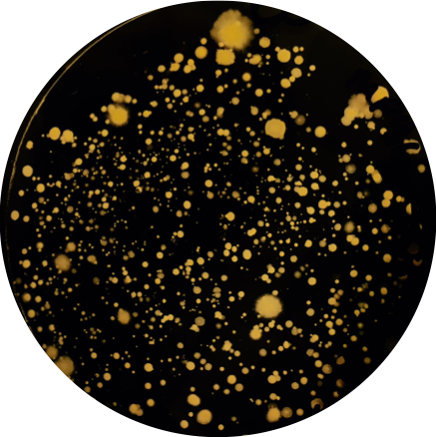
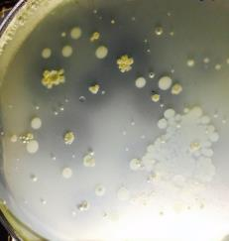
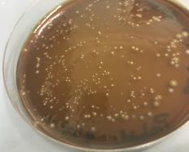
JAX Human Microbiome Strain Collection
Used an anaerobic chamber, bioreactor, other special atmospheres as well as >20 different growth medias to grow organisms from stool
  Pick colonies, gDNA extraction, perform 16S rDNA seq. to ID isolates
>1000 glycerol stocks to date, most single isolates
Total # Phylum: 8
Total # Classes: 14
Total # Orders: 20
Total # Families: 42
Total # Genera: 85
Total # Species: >70
Total # Strains: >365

Slide 36


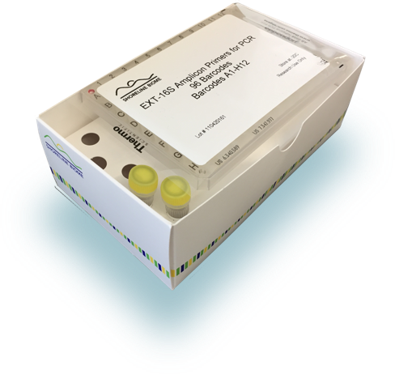
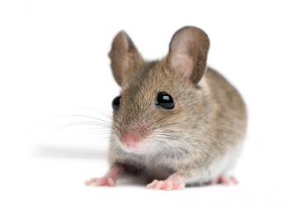
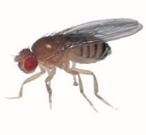

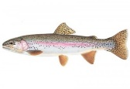

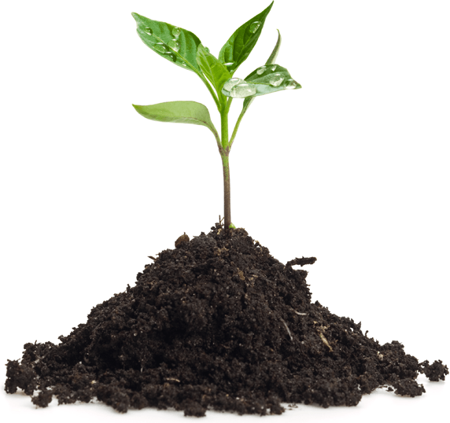

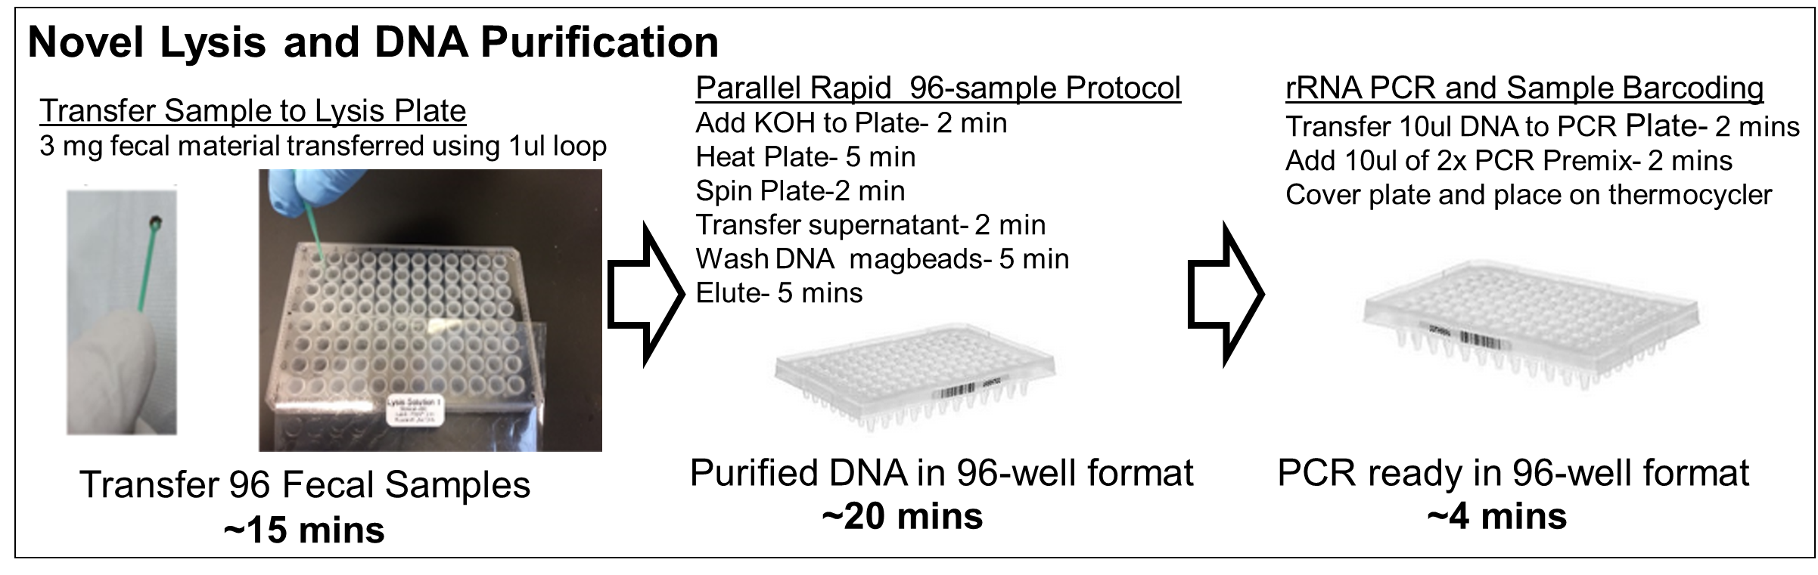
Shoreline Biome 16S rRNA sequencing kit:
Sample to Sequencing to Analysis - One Kit
Human
Fecal, skin and oral swabs, saliva, tissue
Model organisms
Mouse fecal, Drosophila - whole & gut
Environmental
Whole tick, trout fecal, snail, soil, hospital surfaces

Slide 37
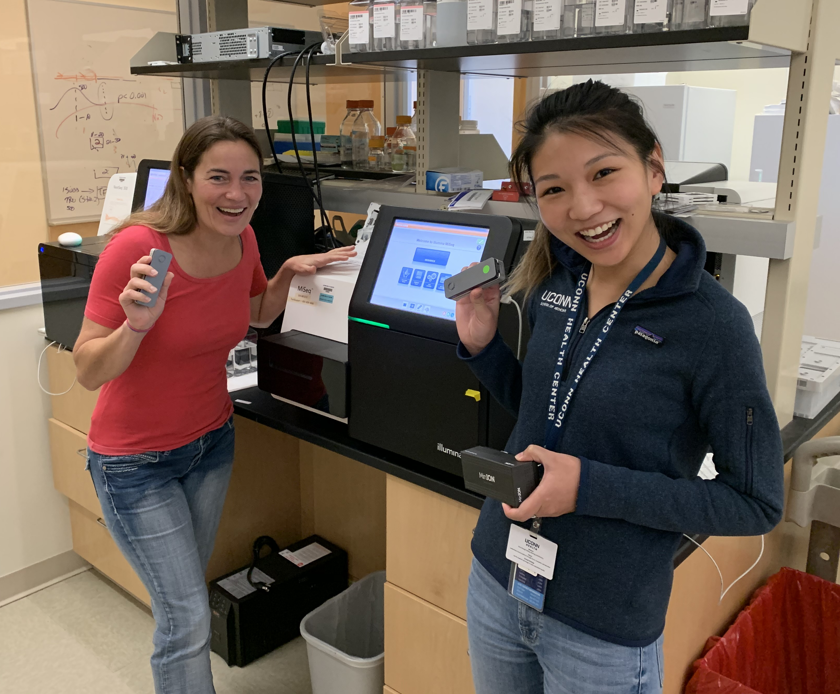
Oxford Nanopore Bacterial Genome Sequencing

Slide 38
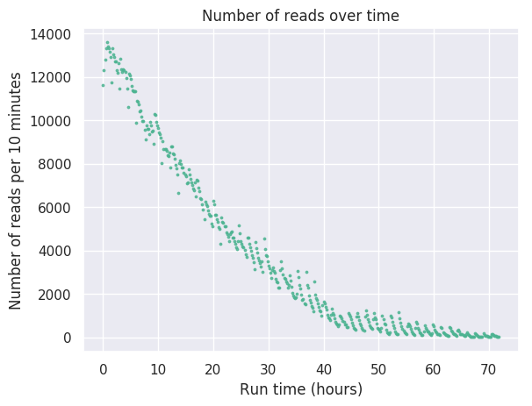
Oxford Nanopore Sequencing Statistics
General summary:
Active channels: |  | 511
Mean read length: |  | 4,080.90
Mean read quality: |  | 9.2
Median read length: |  | 2,325.00
Median read quality: |  | 9.9
Number of reads: |  | 1,609,353.00
Read length N50: |  | 6,564.00
Total bases: |  | 6,567,598,779.00
Number, percentage and megabases of reads above quality cutoffs
>Q5: | 1500331 (93.2%) 6280.9Mb
>Q7: | 1355726 (84.2%) 5789.5Mb
>Q10: | 759326 (47.2%) 3447.3Mb
>Q12: | 27634 (1.7%) 118.9Mb
>Q15: | 2 (0.0%) 0.0Mb
Top 5 longest reads and their mean basecall quality score
1:00 | 105915 (7.7; 74f5b293-59d0-47e5-b7d9-48ae31f634c7)
2:00 | 102359 (11.3; dd21a769-d97b-4e63-9005-52c095e5535a)
3:00 | 102192 (3.2; d24a9923-f0dc-465f-8d94-a4bd82688f2f)
4:00 | 99918 (8.1; 2d968c24-ea10-41db-bc46-c616554acb52)
5:00 | 96876 (7.7; 5688c7c8-88ee-460c-b497-5657f5f7f1e2)

Slide 39
Assembly statistics

Slide 40

Acknowledgments
Jackson Laboratory for Genomic Medicine
Erica Sodergren
Mark Adams
Shana Leopold
Dong-binh Tran
Purva Vats
Sai Lek
Katie Teeter
Lauren Petersen
Hoan Nguyen
Jennifer Chung
Jethro Johnson
Xin Zhou
Dan Philips
Joe Brown
Yini Lek
Current Funding: NIH, NSF, bioMerieux, Moffitt Cancer Center
Jackson Laboratory Bar Harbor
Elissa Chesler
Jason Bubier
Gary Churchill,
Karen Svenson, many others
Thank you to the subjects and their families
U Conn
Yanjiao Zhou
George Kuchel
Daniel Rosenberg
Clinical
Homer Twigg, Ind. Univ. Med. Sch. • Pavlos Papasavas, Hartford Hosp.
Janko Nikolich-Zugich, U. Arizona • Diane Gold, Harvard
Kevan Herold, Yale • Joanne Sordillo, Harvard
Alan Landay, Rush Med. Univ. • Mahboobeh Mahdavinia, Rush
Katherine Gregory, B&W Hospital • Nita Salzman, Med. Coll. Wisc.
Jeff Schwimmer, UCSD • Yang-Yu Liu, Harvard

